Slide 1
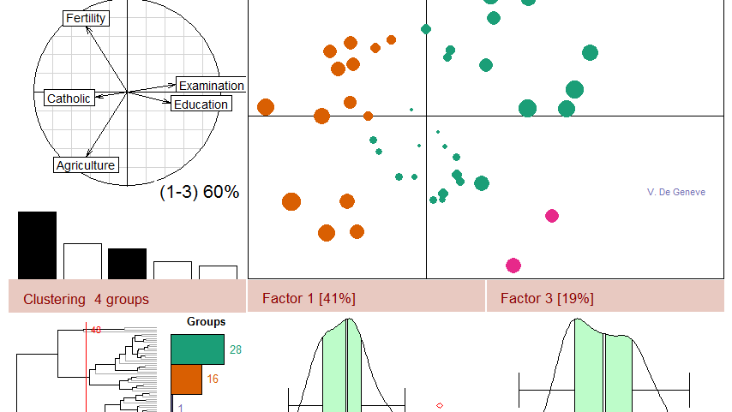

02409 Multivariate Statistics
Lecture G, October 20 2025
Anders Stockmarr
anst@dtu.dk
Course developers:
Anders Stockmarr
Anders Nymark Christensen

Slide 2
Agenda
Concepts in discriminant analysis:
  MINIMAX
  LDF
  QDF
Canonical Discriminant analysis
  Theory
  Examples of use
Introduction to GLM
  The General Linear Model

Slide 3
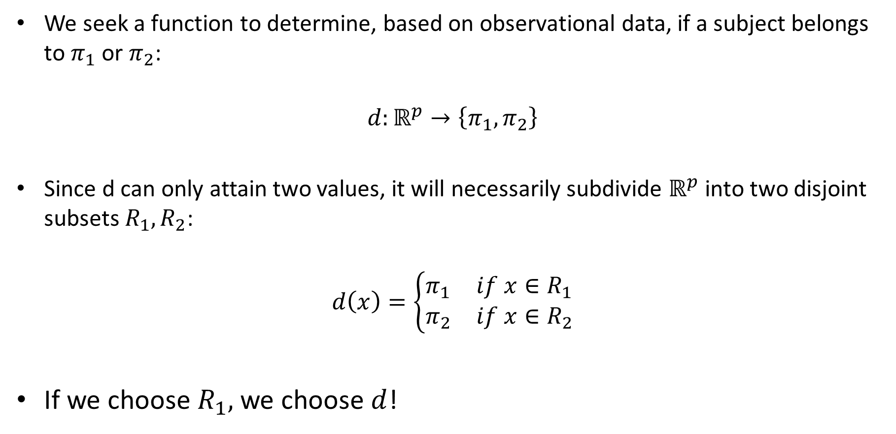
Discriminant Analysis
We seek a function to determine, based on observational data, if a subject belongs to $π_{1}$ or $π_{2}$:
$$d:ℝ^{p}→\left\{π_{1},π_{2}\right\}$$
Since d can only attain two values, it will necessarily subdivide $ℝ^{p}$ into two disjoint subsets $R_{1},R_{2}$:
$$d\left(x\right)=\left\{\begin{matrix}π_{1} & if x∈R_{1} \\ π_{2} & if x∈R_{2}\end{matrix}\right.$$
If we choose $R_{1},$we choose $d$!

Slide 4
The Bayes and Minimax Solutions

Slide 5

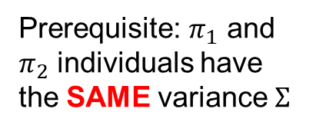
The Linear Discriminator
Prerequisite: $π_{1}$ and $π_{2}$ individuals have the SAME variance $Σ$
$$c=\frac{L_{21}p_{2}}{L_{12}p_{1}} / c=\frac{L_{21}}{L_{12}}$$

Slide 6
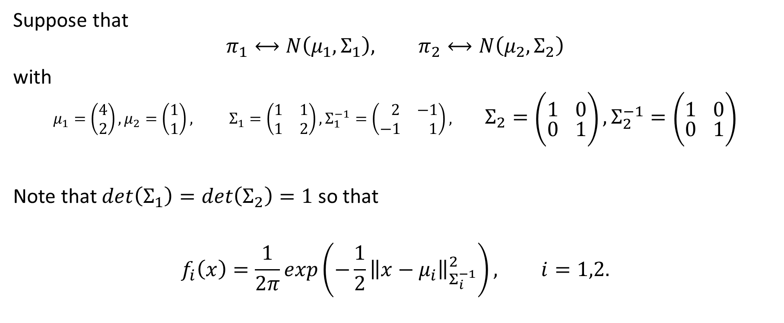
Example
Suppose that
$$π_{1}⟷N\left(μ_{1},Σ_{1}\right), π_{2}⟷N\left(μ_{2},Σ_{2}\right)$$
with
$$μ_{1}=\left(\begin{matrix}4 \\ 2\end{matrix}\right), μ_{2}=\left(\begin{matrix}1 \\ 1\end{matrix}\right), Σ_{1}=\left(\begin{matrix}1 & 1 \\ 1 & 2\end{matrix}\right),Σ_{1}^{−1}=\left(\begin{matrix} 2 & −1 \\ −1 & 1\end{matrix}\right), Σ_{2}=\left(\begin{matrix}1 & 0 \\ 0 & 1\end{matrix}\right),Σ_{2}^{−1}=\left(\begin{matrix}1 & 0 \\ 0 & 1\end{matrix}\right)$$
Note that $det\left(Σ_{1}\right)=\det\left(Σ_{2}\right)=1$ so that
$$f_{i}\left(x\right)=\frac{1}{2π}exp\left(−\frac{1}{2}{\left\|x−μ_{i}\right\|}_{Σ_{i}^{−1}}^{2}\right), i=1,2.$$

Slide 7
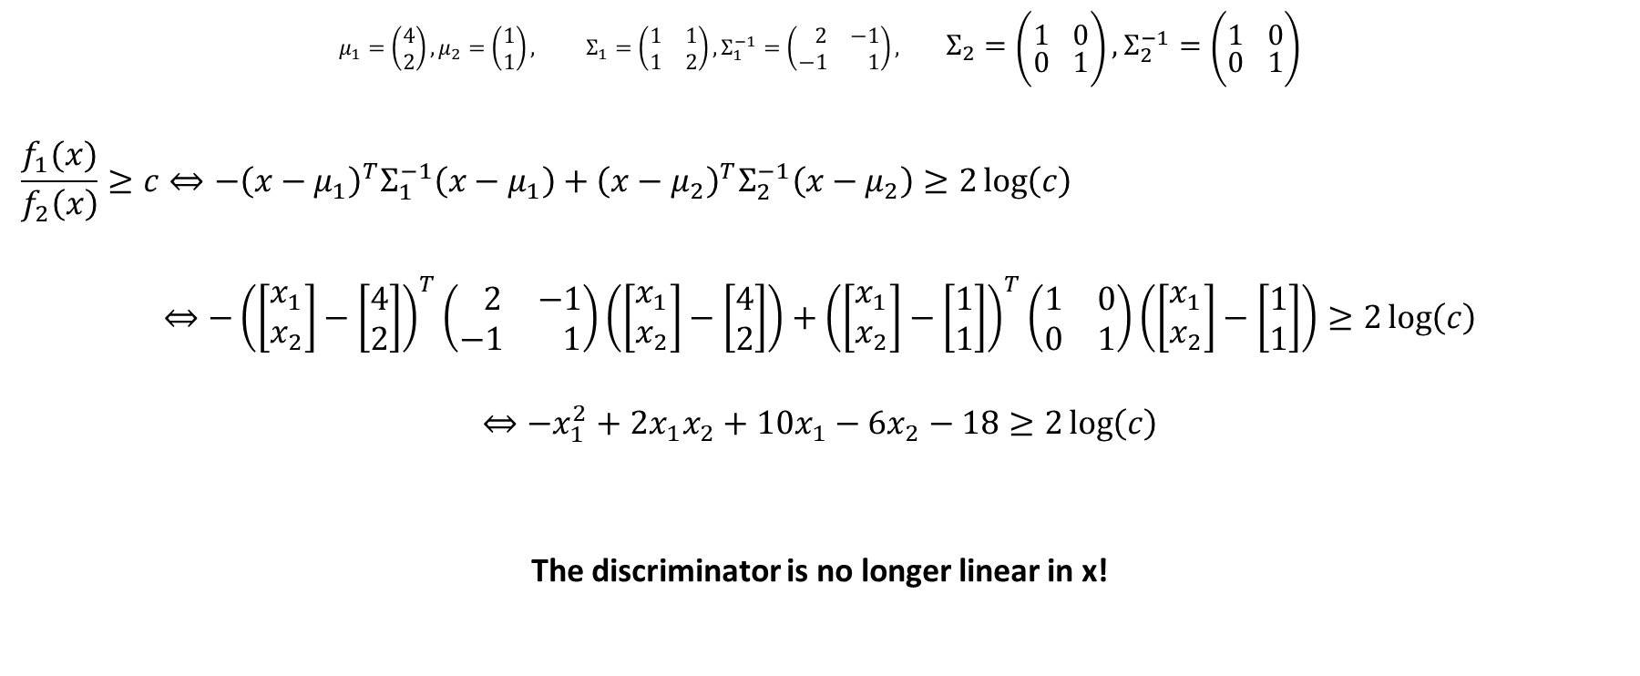
Example
$$μ_{1}=\left(\begin{matrix}4 \\ 2\end{matrix}\right), μ_{2}=\left(\begin{matrix}1 \\ 1\end{matrix}\right), Σ_{1}=\left(\begin{matrix}1 & 1 \\ 1 & 2\end{matrix}\right),Σ_{1}^{−1}=\left(\begin{matrix} 2 & −1 \\ −1 & 1\end{matrix}\right), Σ_{2}=\left(\begin{matrix}1 & 0 \\ 0 & 1\end{matrix}\right),Σ_{2}^{−1}=\left(\begin{matrix}1 & 0 \\ 0 & 1\end{matrix}\right)$$
$$\frac{f_{1}(x)}{f_{2}\left(x\right)}≥c⇔−{\left(x−μ_{1}\right)}^{T}Σ_{1}^{−1}\left(x−μ_{1}\right)+{\left(x−μ_{2}\right)}^{T}Σ_{2}^{−1}\left(x−μ_{2}\right)≥2\log\left(c\right)$$
$$⇔−{\left(\left[\begin{matrix}x_{1} \\ x_{2}\end{matrix}\right]−\left[\begin{matrix}4 \\ 2\end{matrix}\right]\right)}^{T}\left(\begin{matrix} 2 & −1 \\ −1 & 1\end{matrix}\right)\left(\left[\begin{matrix}x_{1} \\ x_{2}\end{matrix}\right]−\left[\begin{matrix}4 \\ 2\end{matrix}\right]\right)+{\left(\left[\begin{matrix}x_{1} \\ x_{2}\end{matrix}\right]−\left[\begin{matrix}1 \\ 1\end{matrix}\right]\right)}^{T}\left(\begin{matrix}1 & 0 \\ 0 & 1\end{matrix}\right)\left(\left[\begin{matrix}x_{1} \\ x_{2}\end{matrix}\right]−\left[\begin{matrix}1 \\ 1\end{matrix}\right]\right)≥2\log\left(c\right)$$
$$⇔−x_{1}^{2}+2x_{1}x_{2}+10x_{1}−6x_{2}−18≥2\log\left(c\right)$$
The discriminator is no longer linear in x!

Slide 8
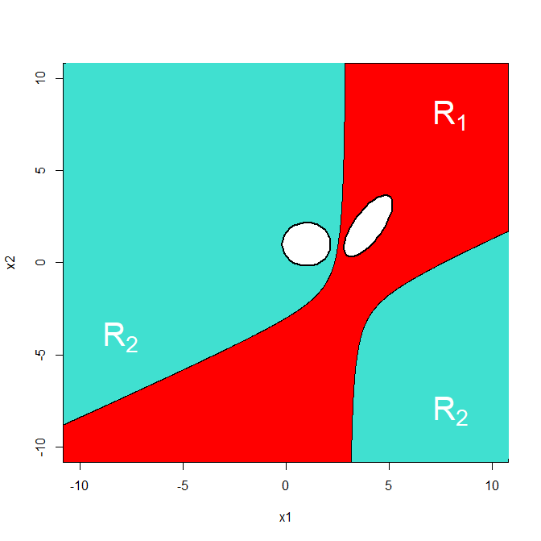

Example
Choose $c=1$, equal loss
$$−x_{1}^{2}+2x_{1}x_{2}+10x_{1}−6x_{2}−18≥0$$
The separation of $ℝ^{2}$ into $R_{1}$ and $R_{2}$ is no longer a hyperplane, but the hyperbola given above:

Slide 9

Working with parameters estimated from data
Asumme again two populations, with $Σ_{1}=Σ_{2}=Σ$ regular.
The Linear Discriminator
$$<x,μ_{1}−μ_{2}>_{Σ^{−1}}−\frac{1}{2}{\left\|μ_{1}\right\|}_{Σ^{−1}}^{2}+\frac{1}{2}{\left\|μ_{2}\right\|}_{Σ^{−1}}^{2}$$
is estimated by
$$<x,{\hat{μ}}_{1}−{\hat{μ}}_{2}>_{{\hat{Σ}}^{−1}}−\frac{1}{2}{\left\|{\hat{μ}}_{1}\right\|}_{{\hat{Σ}}^{−1}}^{2}+\frac{1}{2}{\left\|{\hat{μ}}_{2}\right\|}_{{\hat{Σ}}^{−1}}^{2}$$

Slide 10
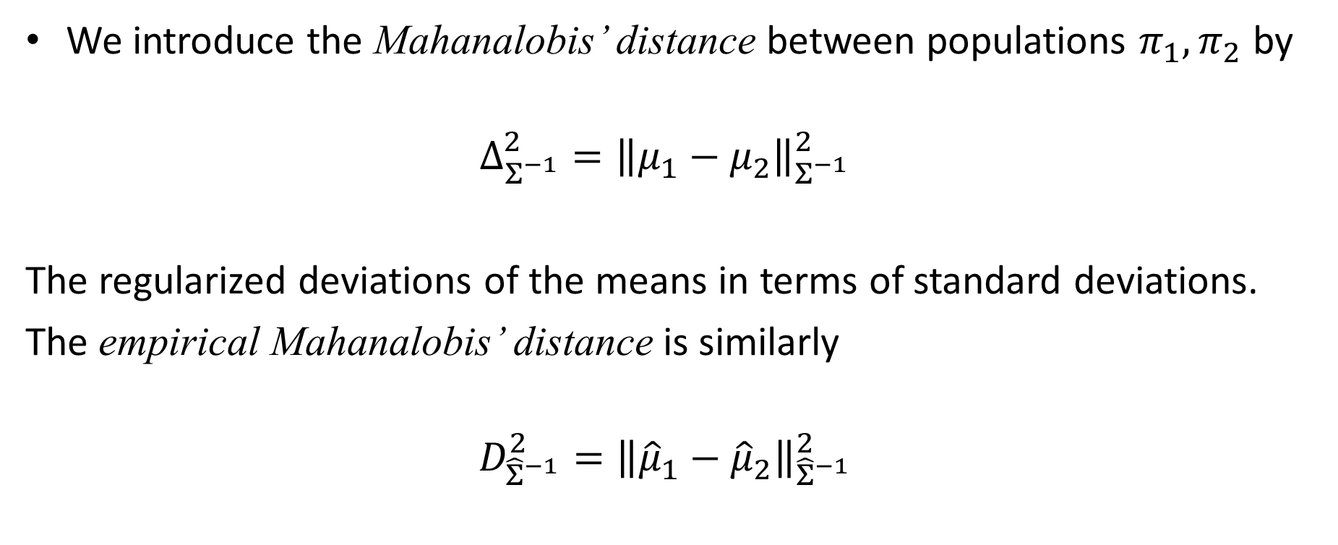
More than two populations:
Distance Between Populations
We introduce the Mahanalobis’ distance between populations $π_{1}, π_{2}$ by
$$Δ_{Σ^{−1}}^{2}={\left\|μ_{1}−μ_{2}\right\|}_{Σ^{−1}}^{2}$$
The regularized deviations of the means in terms of standard deviations.
The empirical Mahanalobis’ distance is similarly
$$D_{{\hat{Σ}}^{−1}}^{2}={\left\|{\hat{μ}}_{1}−{\hat{μ}}_{2}\right\|}_{{\hat{Σ}}^{−1}}^{2}$$

Slide 11

The Mahanalobis’ Distance
The empirical Mahanalobis’ distance
$$D_{ }^{2}={\left\|{\hat{μ}}_{1}−{\hat{μ}}_{2}\right\|}_{{\hat{Σ}}^{−1}}^{2}$$
Can be used to test if $μ_{1}=μ_{2}$

Slide 12

2-sample Test In One Dimension
$$X_{1i}\sim N\left(μ_{1},σ^{2}\right), X_{2i}\sim N\left(μ_{2},σ^{2}\right), i=1,…,n$$
$${\hat{μ}}_{1}−{\hat{μ}}_{2}\sim N\left(0,\frac{2}{n}σ^{2}\right), 2\left(n−1\right){\hat{σ}}^{2}\sim σ⋅χ_{2\left(n−1\right)}^{2}$$
$$T=\sqrt{\frac{n}{2}}\frac{\left({\hat{μ}}_{1}−{\hat{μ}}_{2}\right)}{\sqrt{{\hat{σ}}^{2}}}\sim t\left(2\left(n−1\right)\right), T^{2}=\frac{n}{2}\frac{{\left({\hat{μ}}_{1}−{\hat{μ}}_{2}\right)}^{2}}{{\hat{σ}}^{2}}\sim F(1,2\left(n−1\right))$$

Slide 13
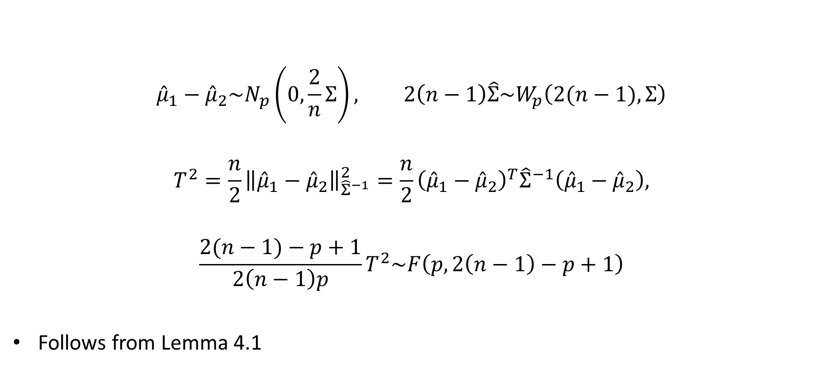
2-sample Test In p Dimensions
$${\hat{μ}}_{1}−{\hat{μ}}_{2}\sim N_{p}\left(0,\frac{2}{n}Σ\right), 2\left(n−1\right)\hat{Σ}\sim W_{p}\left(2(n−1),Σ\right)$$
$$T^{2}=\frac{n}{2}{\left\|{\hat{μ}}_{1}−{\hat{μ}}_{2}\right\|}_{{\hat{Σ}}^{−1}}^{2}=\frac{n}{2}{\left({\hat{μ}}_{1}−{\hat{μ}}_{2}\right)}^{T}{\hat{Σ}}^{−1}\left({\hat{μ}}_{1}−{\hat{μ}}_{2}\right),$$
$$\frac{2(n−1)−p+1}{2\left(n−1\right)p}T^{2}\sim F\left(p,2\left(n−1\right)−p+1\right)$$
Follows from Lemma 4.1
Notes:
p=1: Generalizes previous Slide. T^2 er Hotellings T^2

Slide 14

2-sample Test In p Dimensions
$T^{2}$ when numbers of observations in the groups are uneven:
$$T^{2}=\frac{n_{1}n_{2}}{n_{1}+n_{2}}{\left\|{\hat{μ}}_{1}−{\hat{μ}}_{2}\right\|}_{{\hat{Σ}}^{−1}}^{2},$$
$$\frac{n_{1}+n_{2}−p−1}{\left(n_{1}+n_{2}−2\right)p}T^{2}\sim F\left(p,n_{1}+n_{2}−p−1\right)$$
Follows from Lemma 4.1

Slide 15

2-sample Test In p Dimensions
$$D_{ }^{2}=\frac{n_{1}+n_{2}}{n_{1}n_{2}}T^{2}$$

Slide 16

Discrimination Between Several Populations
Bayes Solution:
Populations: $π_{1},…,π_{k}$.
Prior distribution: $g\left(π_{i}\right)=p_{i}, i=1,…,k.$
Loss function:
Notes:
Note: 0 i diagonalen.

Slide 17
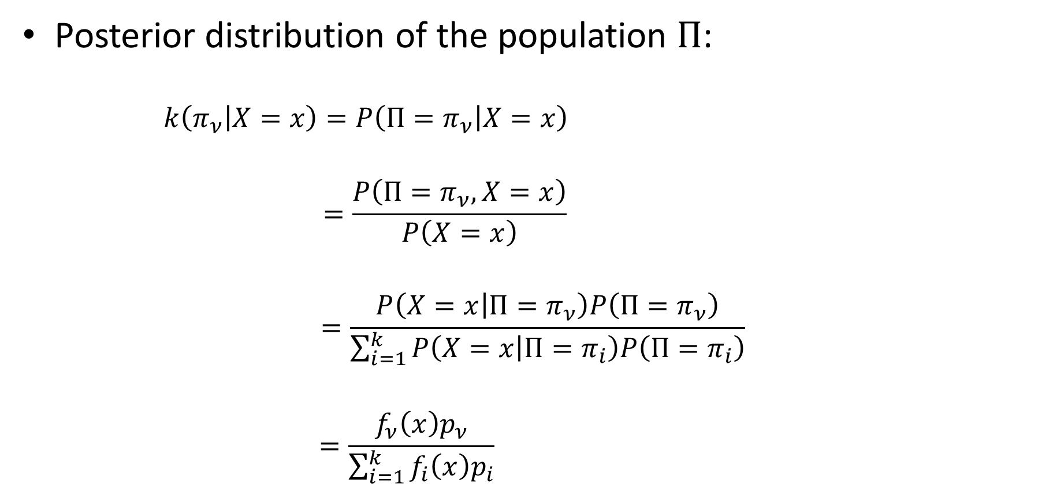
Discrimination Between Several Populations
Posterior distribution of the population $Π$:
$$k\left(π_{ν} | X=x\right)=P\left(Π=π_{ν} | X=x\right)$$
$$=\frac{P\left(Π=π_{ν},X=x\right)}{P\left(X=x\right)}$$
$$=\frac{P\left(X=x | Π=π_{ν}\right)P\left(Π=π_{ν}\right)}{\sum_{i=1}^{k}{P\left(X=x | Π=π_{i}\right)P\left(Π=π_{i}\right)}}$$
$$=\frac{f_{ν}\left(x\right)p_{ν}}{\sum_{i=1}^{k}{f_{i}\left(x\right)p_{i}}}$$
Notes:
Note: f(x) er densities, kan benyttes da vi taler ratios, jfr. limiting argument i lecture F.

Slide 18
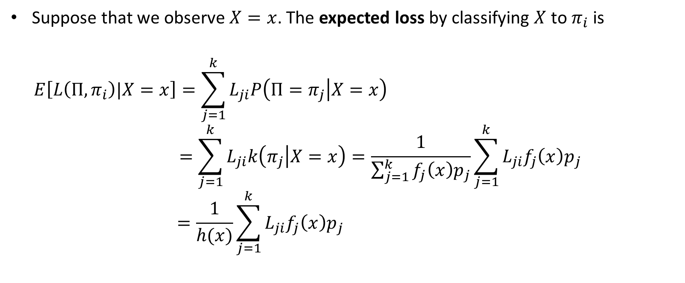
Discrimination Between Several Populations
Suppose that we observe $X=x$. The expected loss by classifying $X$ to $π_{i}$ is
$$E\left[L\left(Π,π_{i}\right)|X=x\right]=\sum_{j=1}^{k}{L_{ji}P\left(Π=π_{j} | X=x\right)}$$
$$=\sum_{j=1}^{k}{L_{ji}k\left(π_{j} | X=x\right)}=\frac{1}{\sum_{j=1}^{k}{f_{j}\left(x\right)p_{j}}}\sum_{j=1}^{k}{L_{ji}f_{j}\left(x\right)p_{j}}$$
$$=\frac{1}{h(x)}\sum_{j=1}^{k}{L_{ji}f_{j}\left(x\right)p_{j}}$$
Notes:
$\frac{1}{\sum_{j=1}^{k}{f_{j}\left(x\right)p_{j}}}$ doesn’t depend on the loss.

Slide 19
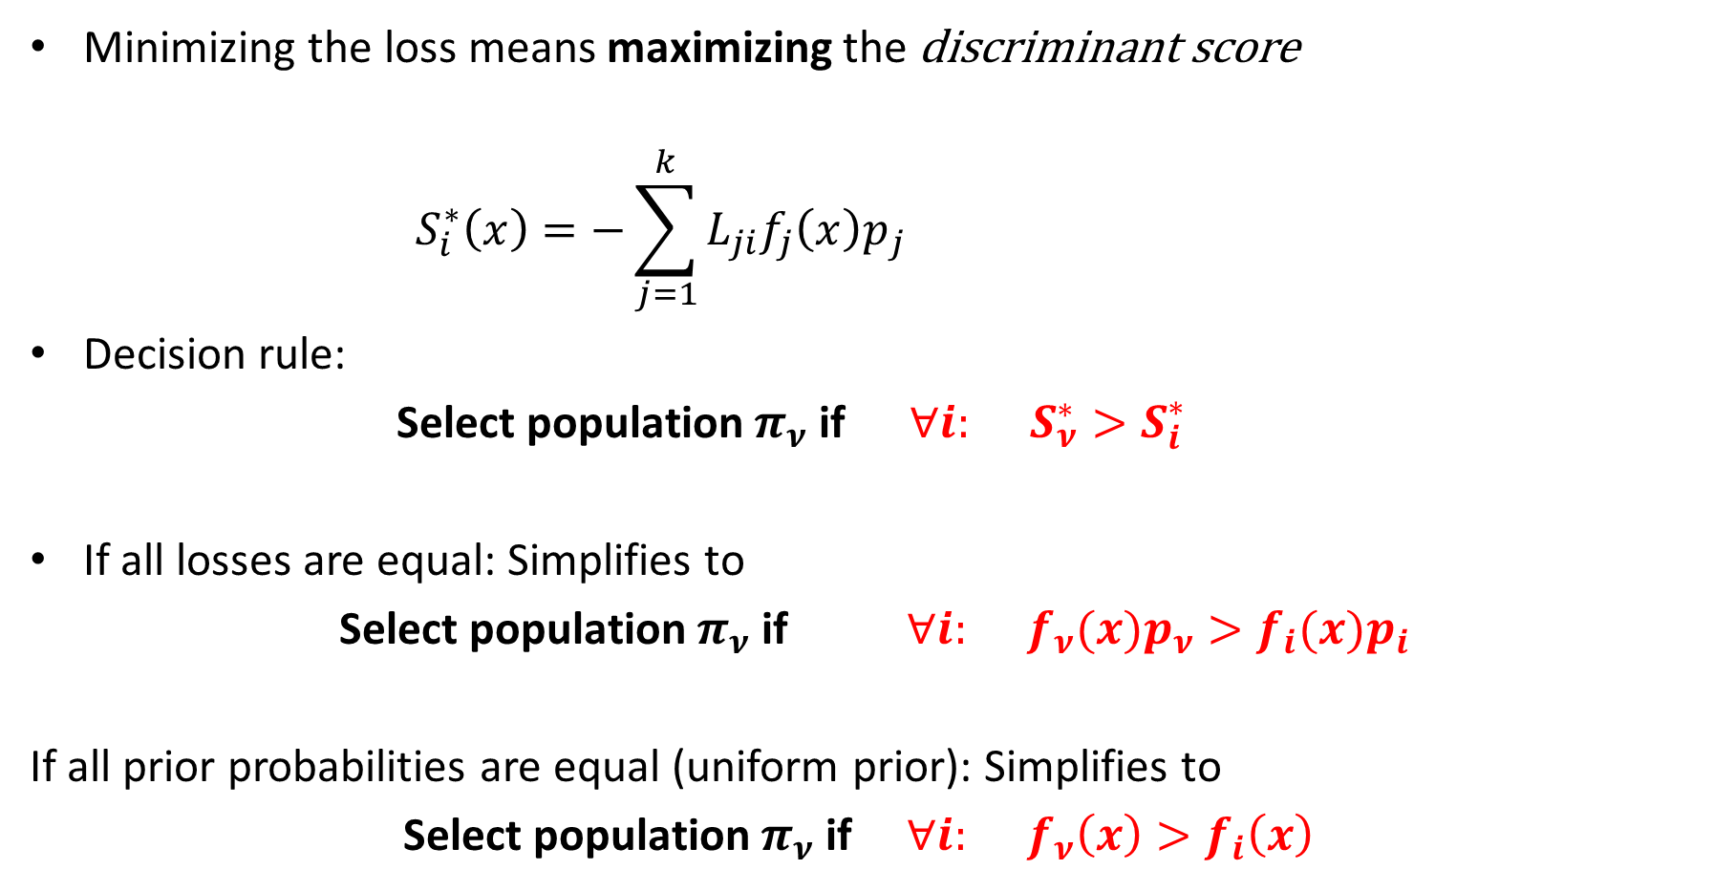
Discrimination Between Several Populations
Minimizing the loss means maximizing the discriminant score
$$S_{i}^{∗}\left(x\right)=−\sum_{j=1}^{k}{L_{ji}f_{j}\left(x\right)p_{j}}$$
Decision rule:
Select population $π_{ν}$ if $∀i: S_{ν}^{∗}>S_{i}^{∗}$
If all losses are equal: Simplifies to
Select population $π_{ν}$ if $∀i: f_{ν}(x)p_{ν}>f_{i}(x)p_{i}$
If all prior probabilities are equal (uniform prior): Simplifies to
Select population $π_{ν}$ if $∀i: f_{ν}\left(x\right)>f_{i}\left(x\right)$
Notes:
$\frac{1}{\sum_{j=1}^{k}{f_{j}\left(x\right)p_{j}}}$ doesn’t depend on the loss.

Slide 20
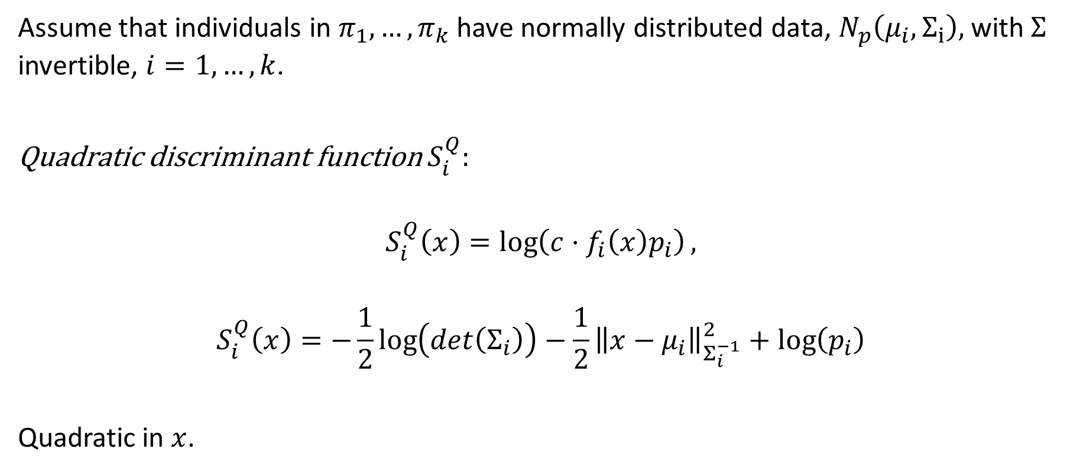
The Case of Normal Distributions
Assume that individuals in $π_{1},…,π_{k}$ have normally distributed data, $N_{p}\left(μ_{i},Σ_{i}\right),$ with $Σ$ invertible, $i=1,…,k$.
Quadratic discriminant function $S_{i}^{Q}:$
$$S_{i}^{Q}\left(x\right)=\log\left(c⋅f_{i}\left(x\right)p_{i}\right),$$
$$S_{i}^{Q}\left(x\right)=−\frac{1}{2}\log\left(det\left(Σ_{i}\right)\right)−\frac{1}{2}{\left\|x−μ_{i}\right\|}_{Σ_{i}^{−1}}^{2}+log⁡\left(p_{i}\right)$$
Quadratic in $x$.
Notes:
c hosen to make the formula as below, eliminating unnecessary factors

Slide 21
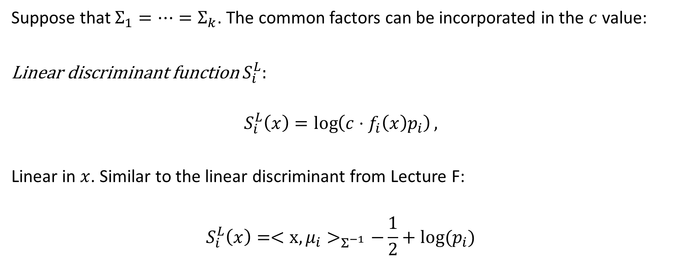
The Case of Normal Distributions
Suppose that $Σ_{1}=⋯=Σ_{k}$. The common factors can be incorporated in the $c$ value:
Linear discriminant function $S_{i}^{L}:$
$$S_{i}^{L}\left(x\right)=\log\left(c⋅f_{i}\left(x\right)p_{i}\right),$$
Linear in $x$. Similar to the linear discriminant from Lecture F:
$$S_{i}^{L}\left(x\right)=<x,μ_{i}>_{Σ_{ }^{−1}}−\frac{1}{2}+log⁡(p_{i})$$
Notes:
C is adapted to remove the common determinant from the expression.

Slide 22

Example
Suppose that $k=3$ with
$μ_{1}=\left[\begin{matrix}4 \\ 2\end{matrix}\right]$, $μ_{2}=\left[\begin{matrix}1 \\ 1\end{matrix}\right]$, $μ_{3}=\left[\begin{matrix}2 \\ 6\end{matrix}\right]$ and $Σ_{1}=Σ_{2}=Σ_{3}=Σ=\left[\begin{matrix}1 & 1 \\ 1 & 2\end{matrix}\right]$
Note that $Σ^{−1}=\left[\begin{matrix} 2 & −1 \\ −1 & 1\end{matrix}\right].$
Assume equal losses and uniform prior.

Slide 23
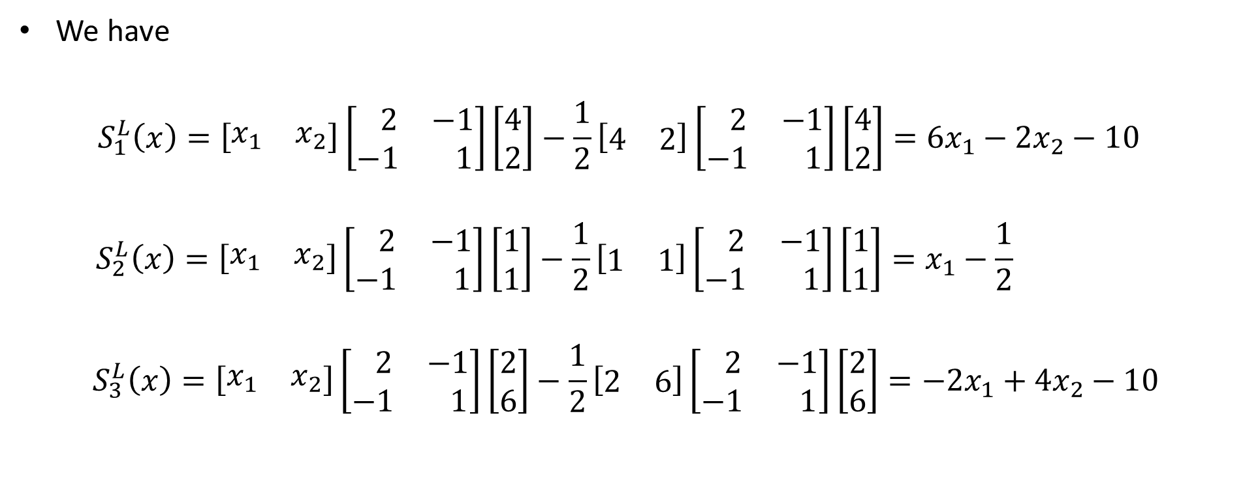
Example
We have
$$S_{1}^{L}\left(x\right)=\left[\begin{matrix}x_{1} & x_{2}\end{matrix}\right]\left[\begin{matrix} 2 & −1 \\ −1 & 1\end{matrix}\right]\left[\begin{matrix}4 \\ 2\end{matrix}\right]−\frac{1}{2}\left[\begin{matrix}4 & 2\end{matrix}\right]\left[\begin{matrix} 2 & −1 \\ −1 & 1\end{matrix}\right]\left[\begin{matrix}4 \\ 2\end{matrix}\right]=6x_{1}−2x_{2}−10$$
$$S_{2}^{L}\left(x\right)=\left[\begin{matrix}x_{1} & x_{2}\end{matrix}\right]\left[\begin{matrix} 2 & −1 \\ −1 & 1\end{matrix}\right]\left[\begin{matrix}1 \\ 1\end{matrix}\right]−\frac{1}{2}\left[\begin{matrix}1 & 1\end{matrix}\right]\left[\begin{matrix} 2 & −1 \\ −1 & 1\end{matrix}\right]\left[\begin{matrix}1 \\ 1\end{matrix}\right]=x_{1}−\frac{1}{2}$$
$$S_{3}^{L}\left(x\right)=\left[\begin{matrix}x_{1} & x_{2}\end{matrix}\right]\left[\begin{matrix} 2 & −1 \\ −1 & 1\end{matrix}\right]\left[\begin{matrix}2 \\ 6\end{matrix}\right]−\frac{1}{2}\left[\begin{matrix}2 & 6\end{matrix}\right]\left[\begin{matrix} 2 & −1 \\ −1 & 1\end{matrix}\right]\left[\begin{matrix}2 \\ 6\end{matrix}\right]=−2x_{1}+4x_{2}−10$$

Slide 24
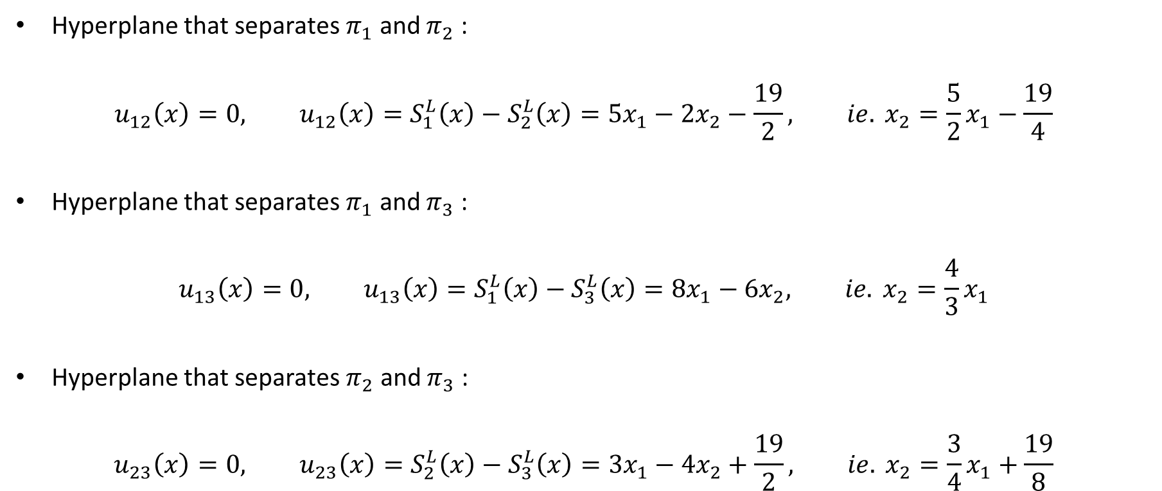
Example
Hyperplane that separates $π_{1}$ and $π_{2}$ :
$$u_{12}\left(x\right)=0, u_{12}\left(x\right)=S_{1}^{L}\left(x\right)−S_{2}^{L}\left(x\right)=5x_{1}−2x_{2}−\frac{19}{2}, ie. x_{2}=\frac{5}{2}x_{1}−\frac{19}{4}$$
Hyperplane that separates $π_{1}$ and $π_{3}$ :
$$u_{13}\left(x\right)=0, u_{13}\left(x\right)=S_{1}^{L}\left(x\right)−S_{3}^{L}\left(x\right)=8x_{1}−6x_{2}, ie. x_{2}=\frac{4}{3}x_{1}$$
Hyperplane that separates $π_{2}$ and $π_{3}$ :
$$u_{23}\left(x\right)=0, u_{23}\left(x\right)=S_{2}^{L}\left(x\right)−S_{3}^{L}\left(x\right)=3x_{1}−4x_{2}+\frac{19}{2}, ie. x_{2}=\frac{3}{4}x_{1}+\frac{19}{8}$$

Slide 25
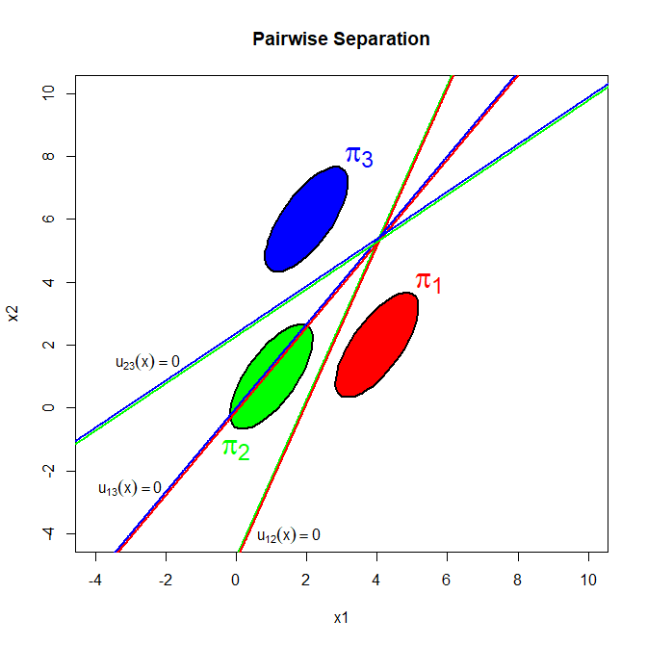
Example

Slide 26
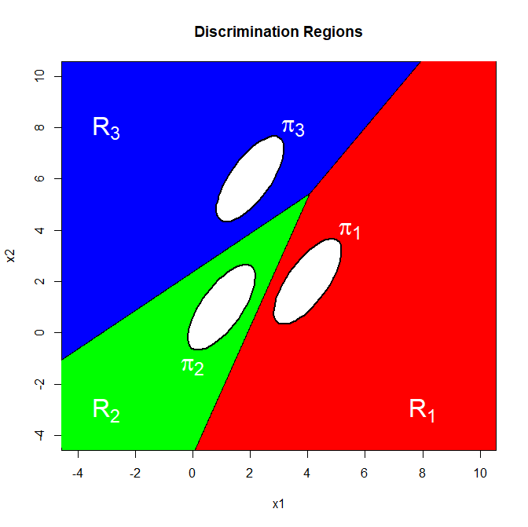
Example

Slide 27
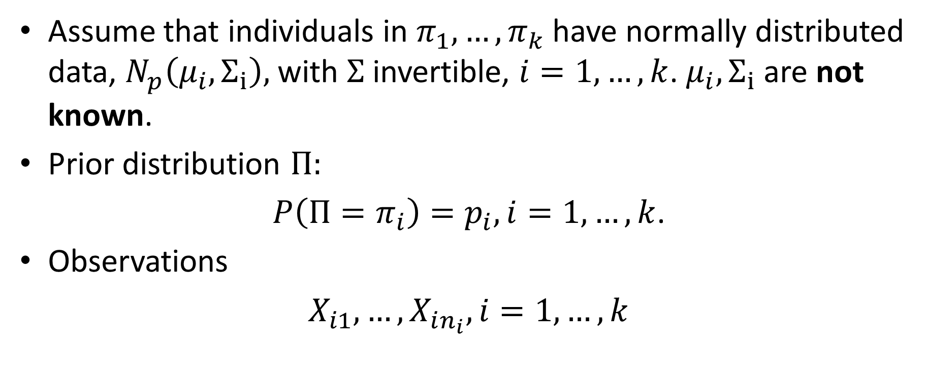
The Case of Normal Distributions,
Unknown Parameters
Assume that individuals in $π_{1},…,π_{k}$ have normally distributed data, $N_{p}\left(μ_{i},Σ_{i}\right),$ with $Σ$ invertible, $i=1,…,k$. $μ_{i},Σ_{i}$ are not known.
Prior distribution $Π:$
$P\left(Π=π_{i}\right)=p_{i}, i=1,…, k$.
Observations
$X_{i1},…,X_{in_{i}}, i=1,…,k$

Slide 28
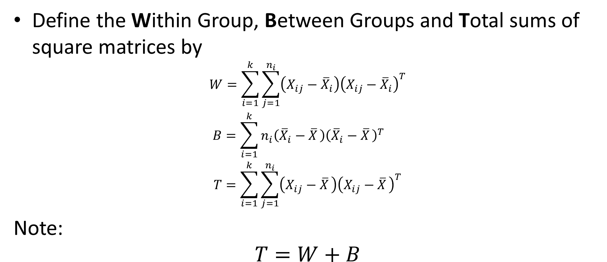
The Case of Normal Distributions,
Unknown Parameters
Define the Within Group, Between Groups and Total sums of square matrices by
$$\begin{matrix}W=\sum_{i=1}^{k}{\sum_{j=1}^{n_{i}}{\left(X_{ij}−{\overline{X}}_{i}\right){\left(X_{ij}−{\overline{X}}_{i}\right)}^{T}}} \\ B=\sum_{i=1}^{k}{n_{i}\left({\overline{X}}_{i}−{\overline{X}}_{ }\right){\left({\overline{X}}_{i}−{\overline{X}}_{ }\right)}^{T}} \\ T=\sum_{i=1}^{k}{\sum_{j=1}^{n_{i}}{\left(X_{ij}−{\overline{X}}_{ }\right){\left(X_{ij}−{\overline{X}}_{ }\right)}^{T}}}\end{matrix}$$
Note:
$$T=W+B$$

Slide 29
The Case of Normal Distributions,
Unknown Parameters
Define the Within Group, Between Groups and Total sums of square matrices by
$$\begin{matrix}W=\sum_{i=1}^{k}{\sum_{j=1}^{n_{i}}{\left(X_{ij}−{\overline{X}}_{i}\right){\left(X_{ij}−{\overline{X}}_{i}\right)}^{T}}} \\ B=\sum_{i=1}^{k}{n_{i}\left({\overline{X}}_{i}−{\overline{X}}_{ }\right){\left({\overline{X}}_{i}−{\overline{X}}_{ }\right)}^{T}} \\ T=\sum_{i=1}^{k}{\sum_{j=1}^{n_{i}}{\left(X_{ij}−{\overline{X}}_{ }\right){\left(X_{ij}−{\overline{X}}_{ }\right)}^{T}}}\end{matrix}$$
Note:
$$T=W+B$$
Notes:
Vi skal bruge disse concepter senere, lige nu fokuserer vi på W til parameter estimation.

Slide 30
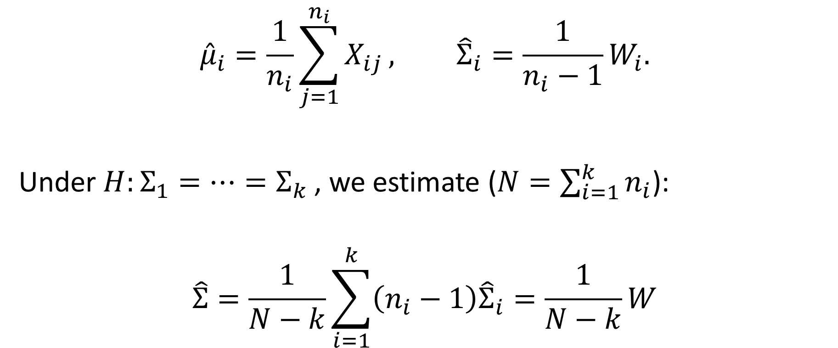
Parameter Estimation
$${\hat{μ}}_{i}=\frac{1}{n_{i}}\sum_{j=1}^{n_{i}}{X_{ij}}, {\hat{Σ}}_{i}=\frac{1}{n_{i}−1}W_{i}.$$
Under $H:Σ_{1}=⋯=Σ_{k}$, we estimate ($N=\sum_{i=1}^{k}{n_{i}}$):
$$\hat{Σ}=\frac{1}{N−k}\sum_{i=1}^{k}{\left(n_{i}−1\right){\hat{Σ}}_{i}}=\frac{1}{N−k}W$$

Slide 31
Distance Between Populations

Slide 32
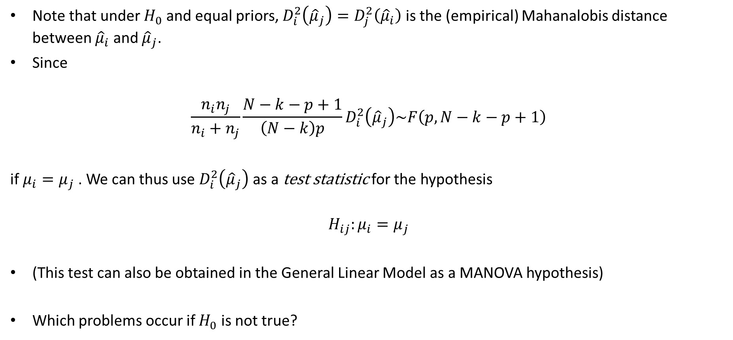
Distance Between Populations
Note that under $H_{0}$ and equal priors, $D_{i}^{2}\left({\hat{μ}}_{j}\right)=D_{j}^{2}\left({\hat{μ}}_{i}\right)$ is the (empirical) Mahanalobis distance between ${\hat{μ}}_{i}$ and ${\hat{μ}}_{j}$.
Since
$$\frac{n_{i}n_{j}}{n_{i}+n_{j}}\frac{N−k−p+1}{\left(N−k\right)p}D_{i}^{2}\left({\hat{μ}}_{j}\right)\sim F\left(p,N−k−p+1\right)$$
if $μ_{i}=μ_{j}$. We can thus use $D_{i}^{2}\left({\hat{μ}}_{j}\right)$ as a test statistic for the hypothesis
$$H_{ij}:μ_{i}=μ_{j}$$
(This test can also be obtained in the General Linear Model as a MANOVA hypothesis)
Which problems occur if $H_{0}$ is not true?
Notes:
Formula from Lemma 4.1 page 278. If H_0 is not true, then $D_{i}^{2}\left({\hat{μ}}_{j}\right)≠D_{j}^{2}\left({\hat{μ}}_{i}\right)$ for some i and j, and the test is no longer symmetric in i and j.

Slide 33
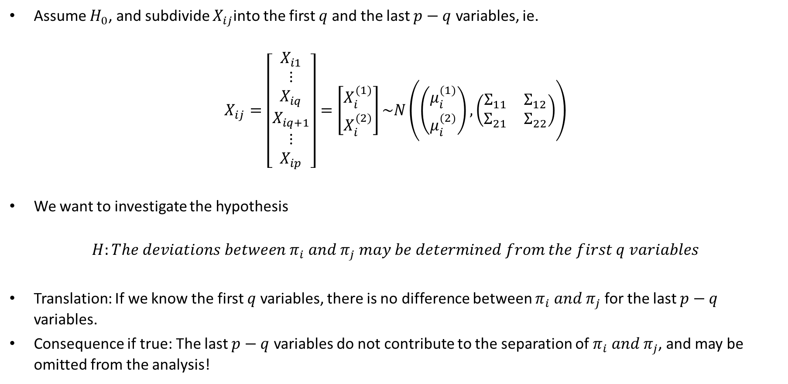
Test for Additional Information
Assume $H_{0}$, and subdivide $X_{ij}$into the first $q$ and the last $p−q$ variables, ie.
$$X_{ij}=\left[\begin{matrix}\begin{matrix}X_{i1} \\ ⋮ \\ X_{iq}\end{matrix} \\ \begin{matrix}X_{iq+1} \\ ⋮ \\ X_{ip}\end{matrix}\end{matrix}\right]=\left[\begin{matrix}X_{i}^{(1)} \\ X_{i}^{(2)}\end{matrix}\right]\sim N\left(\left(\begin{matrix}μ_{i}^{(1)} \\ μ_{i}^{(2)}\end{matrix}\right),\left(\begin{matrix}Σ_{11} & Σ_{12} \\ Σ_{21} & Σ_{22}\end{matrix}\right)\right)$$
We want to investigate the hypothesis
$$H:The deviations between π_{i} and π_{j} may be determined from the first q variables$$
Translation: If we know the first $q$ variables, there is no difference between $π_{i} and π_{j}$ for the last $p−q$ variables.
Consequence if true: The last $p−q$ variables do not contribute to the separation of $π_{i} and π_{j}$, and may be omitted from the analysis!

Slide 34
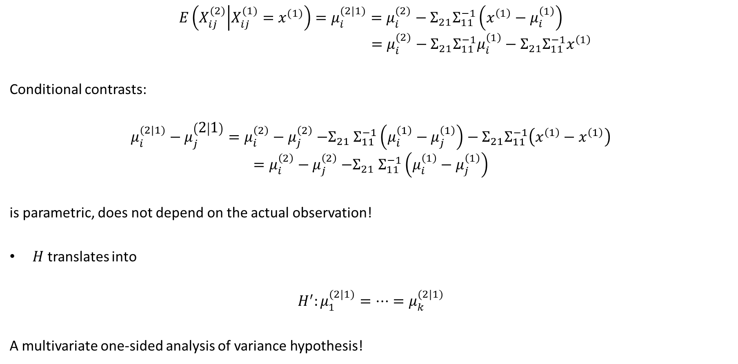
Test for Additional Information
$$E\left(X_{ij}^{(2)} | X_{ij}^{(1)}=x^{(1)}\right)=μ_{i}^{(2|1)}=μ_{i}^{(2)}−Σ_{21}Σ_{11}^{−1}\left(x^{\left(1\right)}−μ_{i}^{\left(1\right)}\right)$$
$$=μ_{i}^{(2)}−Σ_{21}Σ_{11}^{−1}μ_{i}^{\left(1\right)}−Σ_{21}Σ_{11}^{−1}x^{\left(1\right)}$$
Conditional contrasts:
$$μ_{i}^{(2|1)}−μ_{j}^{\left(2 | 1\right)}=μ_{i}^{\left(2\right)}−μ_{j}^{\left(2\right)}{−Σ}_{21}Σ_{11}^{−1}\left(μ_{i}^{\left(1\right)}−μ_{j}^{\left(1\right)}\right)−Σ_{21}Σ_{11}^{−1}\left(x^{\left(1\right)}−x^{\left(1\right)}\right)$$
$$=μ_{i}^{\left(2\right)}−μ_{j}^{\left(2\right)}{−Σ}_{21}Σ_{11}^{−1}\left(μ_{i}^{\left(1\right)}−μ_{j}^{\left(1\right)}\right)$$
is parametric, does not depend on the actual observation!
$H$ translates into
$$H^{′}:μ_{1}^{(2|1)}=⋯{=μ}_{k}^{(2|1)}$$
A multivariate one-sided analysis of variance hypothesis!

Slide 35

Test for Additional Information
Subdivide
$$W=\left[\begin{matrix}W_{11} & W_{12} \\ W_{21} & W_{22}\end{matrix}\right], T=\left[\begin{matrix}T_{11} & T_{12} \\ T_{21} & T_{22}\end{matrix}\right]$$
And construct
$$W_{2|1}=W_{22}−W_{21}W_{11}^{−1}W_{12}, T_{2|1}=T_{22}−T_{21}T_{11}^{−1}T_{12}$$

Slide 36
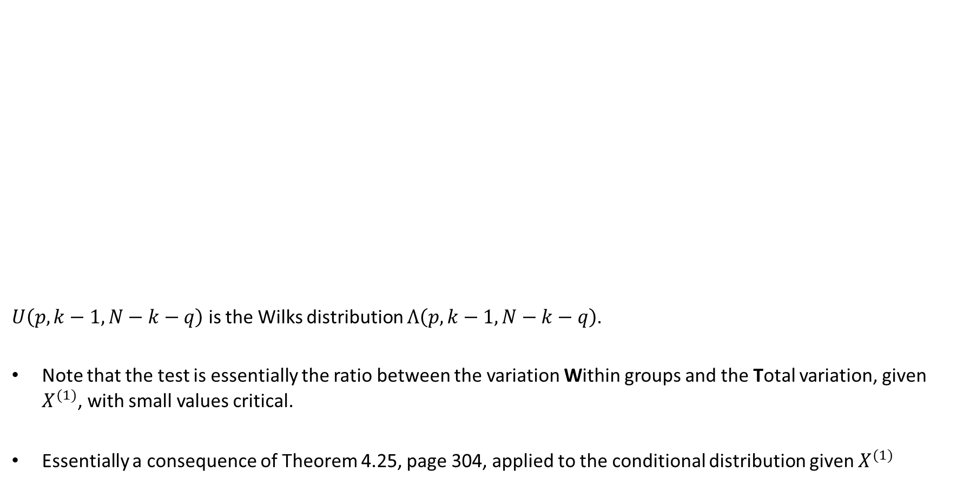
Test for Additional Information
$U\left(p,k−1,N−k−q\right)$ is the Wilks distribution $Λ\left(p,k−1,N−k−q\right)$.
Note that the test is essentially the ratio between the variation Within groups and the Total variation, given $X^{(1)}$, with small values critical.
Essentially a consequence of Theorem 4.25, page 304, applied to the conditional distribution given $X^{(1)}$

Slide 37

Test for Additional Information
F distributions, exact for $p−q=2$ and approximative for $p−q>2$, may be obtained as in Lecture F, slide 19.

Slide 38
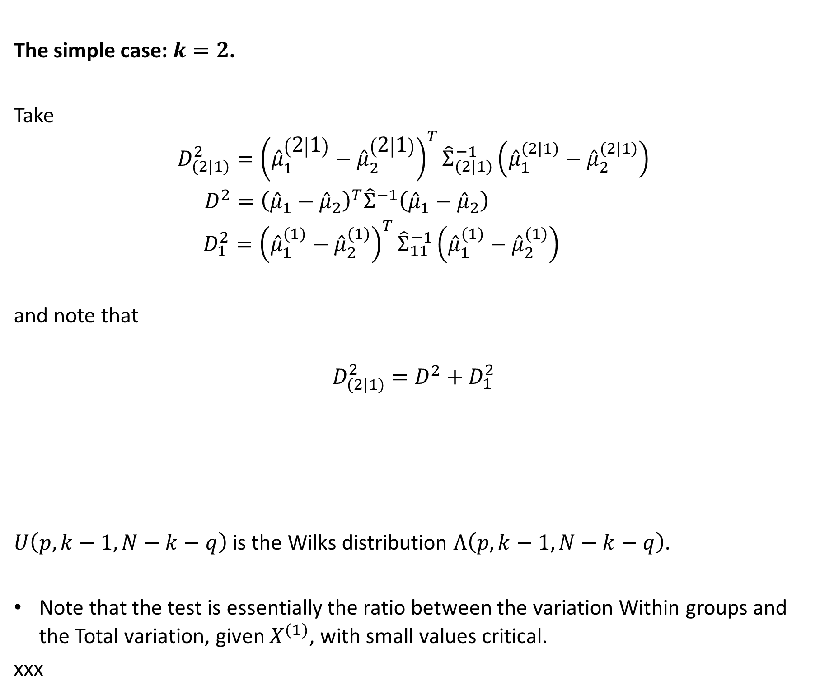
Test for Additional Information
The simple case: $k=2$.
Take
$$\begin{matrix}D_{(2|1)}^{2}={\left({\hat{μ}}_{1}^{\left(2 | 1\right)}−{\hat{μ}}_{2}^{\left(2 | 1\right)}\right)}^{T}{\hat{Σ}}_{(2|1)}^{−1}\left({\hat{μ}}_{1}^{(2|1)}−{\hat{μ}}_{2}^{(2|1)}\right) \\ D_{ }^{2}={\left({\hat{μ}}_{1}^{ }−{\hat{μ}}_{2}^{ }\right)}^{T}{\hat{Σ}}_{ }^{−1}\left({\hat{μ}}_{1}^{ }−{\hat{μ}}_{2}^{ }\right) \\ D_{1}^{2}={\left({\hat{μ}}_{1}^{(1)}−{\hat{μ}}_{2}^{(1)}\right)}^{T}{\hat{Σ}}_{11}^{−1}\left({\hat{μ}}_{1}^{(1)}−{\hat{μ}}_{2}^{(1)}\right) \end{matrix}$$
and note that
$$D_{(2|1)}^{2}=D^{2}+D_{1}^{2}$$
$U\left(p,k−1,N−k−q\right)$ is the Wilks distribution $Λ\left(p,k−1,N−k−q\right)$.
Note that the test is essentially the ratio between the variation Within groups and the Total variation, given $X^{(1)}$, with small values critical.
xxx

Slide 39
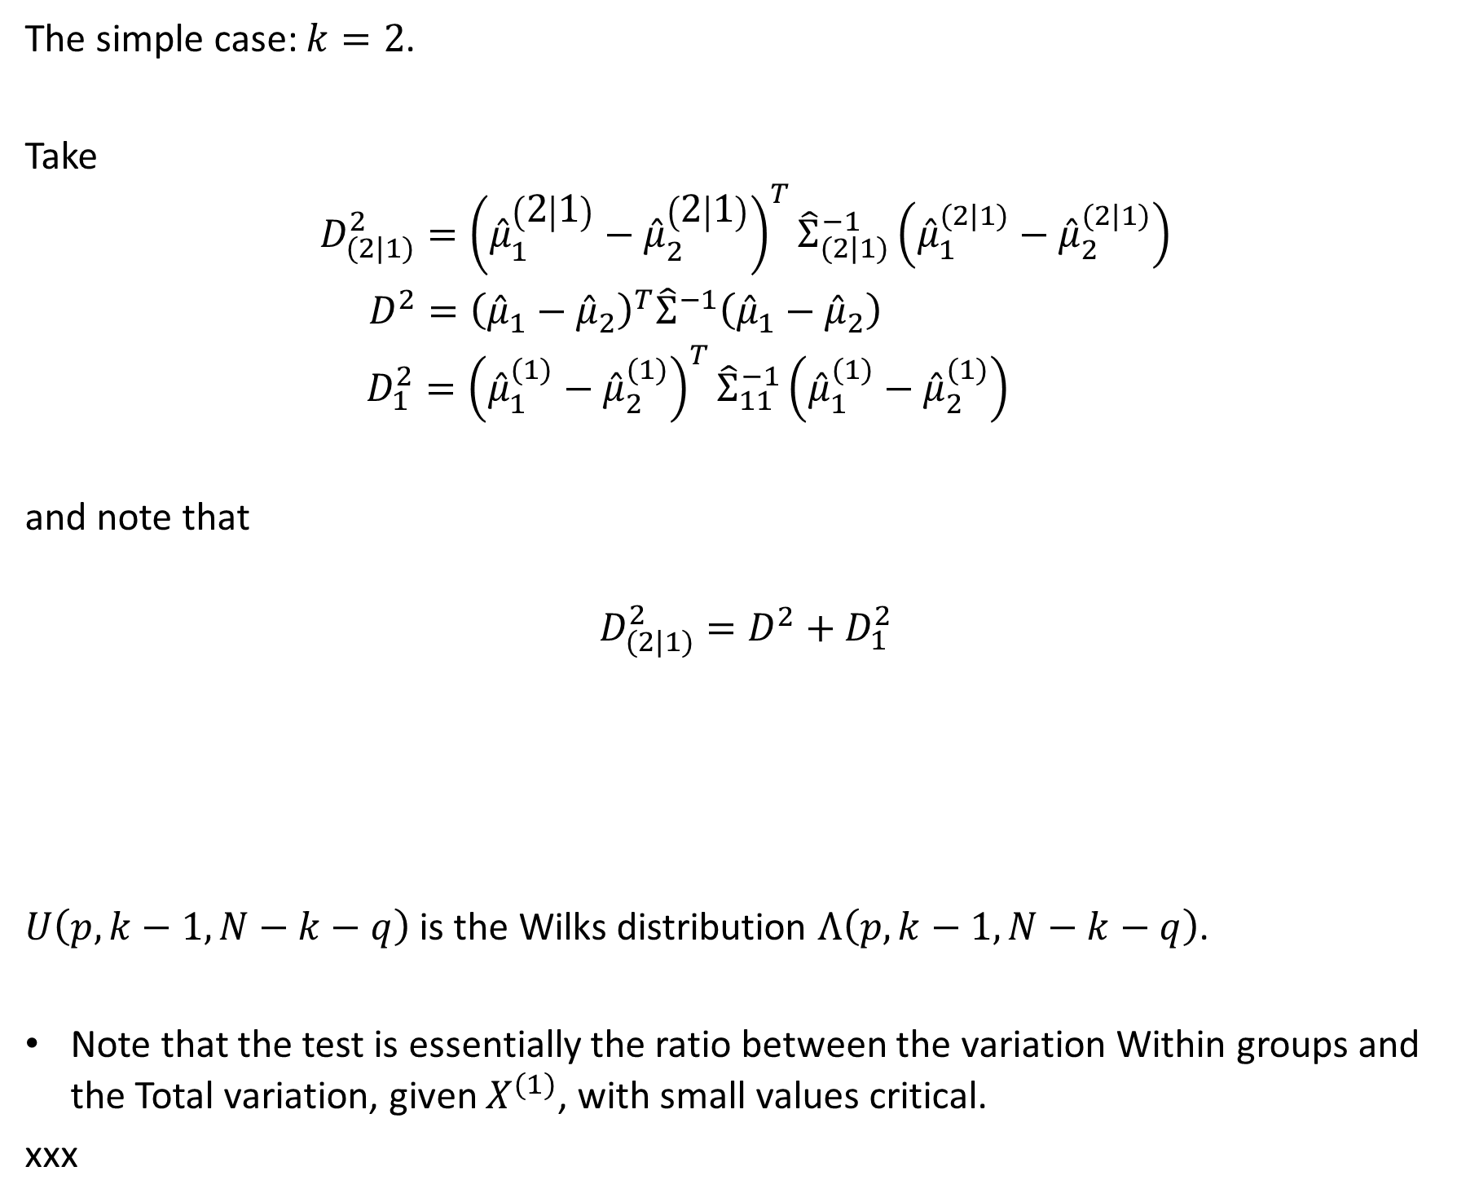
Test for Additional Information
The simple case: $k=2$.
Take
$$\begin{matrix}D_{(2|1)}^{2}={\left({\hat{μ}}_{1}^{\left(2 | 1\right)}−{\hat{μ}}_{2}^{\left(2 | 1\right)}\right)}^{T}{\hat{Σ}}_{(2|1)}^{−1}\left({\hat{μ}}_{1}^{(2|1)}−{\hat{μ}}_{2}^{(2|1)}\right) \\ D_{ }^{2}={\left({\hat{μ}}_{1}^{ }−{\hat{μ}}_{2}^{ }\right)}^{T}{\hat{Σ}}_{ }^{−1}\left({\hat{μ}}_{1}^{ }−{\hat{μ}}_{2}^{ }\right) \\ D_{1}^{2}={\left({\hat{μ}}_{1}^{(1)}−{\hat{μ}}_{2}^{(1)}\right)}^{T}{\hat{Σ}}_{11}^{−1}\left({\hat{μ}}_{1}^{(1)}−{\hat{μ}}_{2}^{(1)}\right) \end{matrix}$$
and note that
$$D_{(2|1)}^{2}=D^{2}+D_{1}^{2}$$
$U\left(p,k−1,N−k−q\right)$ is the Wilks distribution $Λ\left(p,k−1,N−k−q\right)$.
Note that the test is essentially the ratio between the variation Within groups and the Total variation, given $X^{(1)}$, with small values critical.
xxx

Slide 40

Test for Additional Information
The simple case: $k=2$:

Slide 41

Canonical Discriminant Analysis
We maintain $H_{0}.$
Selecting an optimal discriminator:
Should maximize the variation between groups, relative to the variation within groups.
$k=2: δ=Σ^{−1}\left(μ_{1}−μ_{2}\right)$
Notes:
Maximum is the Mahanalobis distance between pi1 and pi2.

Slide 42
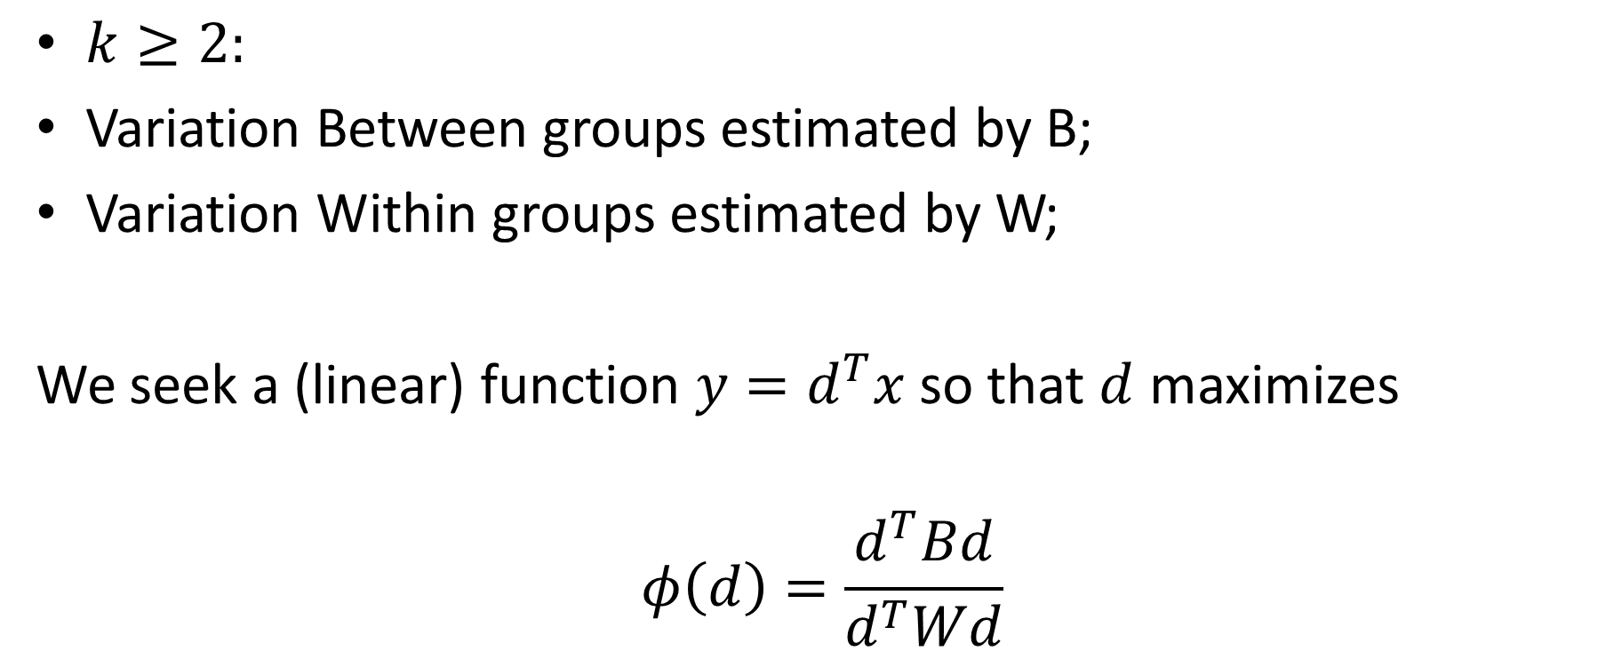
Canonical Discriminant Analysis
$k≥2:$
Variation Between groups estimated by B;
Variation Within groups estimated by W;
We seek a (linear) function $y=d^{T}x$ so that $d$ maximizes
$$φ\left(d\right)=\frac{d^{T}Bd}{d^{T}Wd}$$
Notes:
Solution derived in detail for k=2 on blackboard in lecture F.

Slide 43
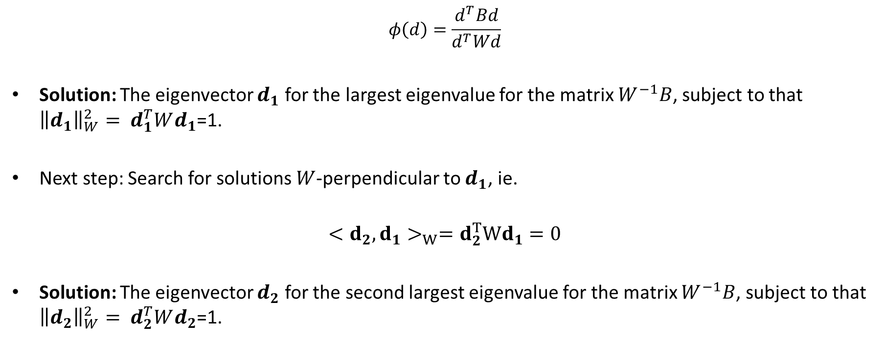
Canonical Discriminant Analysis
$$φ\left(d\right)=\frac{d^{T}Bd}{d^{T}Wd}$$
Solution: The eigenvector $d_{1}$ for the largest eigenvalue for the matrix $W^{−1}B$, subject to that ${{\left\|d_{1}\right\|}_{W}^{2}=}^{ }d_{1}^{T}Wd_{1}$=1.
Next step: Search for solutions $W$-perpendicular to $d_{1}$, ie.
$$<d_{2},d_{1}>_{W}=d_{2}^{T}Wd_{1}=0$$
Solution: The eigenvector $d_{2}$ for the second largest eigenvalue for the matrix $W^{−1}B$, subject to that ${{\left\|d_{2}\right\|}_{W}^{2}=}^{ }d_{2}^{T}Wd_{2}$=1.

Slide 44
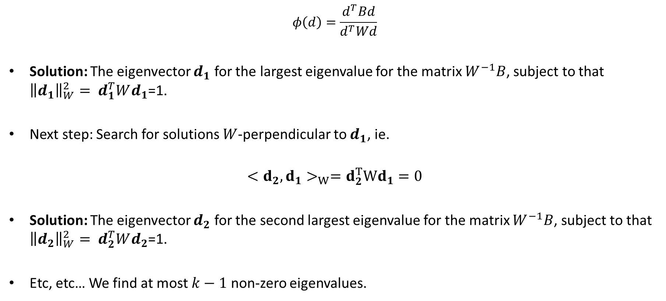
Canonical Discriminant Analysis
$$φ\left(d\right)=\frac{d^{T}Bd}{d^{T}Wd}$$
Solution: The eigenvector $d_{1}$ for the largest eigenvalue for the matrix $W^{−1}B$, subject to that ${{\left\|d_{1}\right\|}_{W}^{2}=}^{ }d_{1}^{T}Wd_{1}$=1.
Next step: Search for solutions $W$-perpendicular to $d_{1}$, ie.
$$<d_{2},d_{1}>_{W}=d_{2}^{T}Wd_{1}=0$$
Solution: The eigenvector $d_{2}$ for the second largest eigenvalue for the matrix $W^{−1}B$, subject to that ${{\left\|d_{2}\right\|}_{W}^{2}=}^{ }d_{2}^{T}Wd_{2}$=1.
Etc, etc… We find at most $k−1$ non-zero eigenvalues.

Slide 45
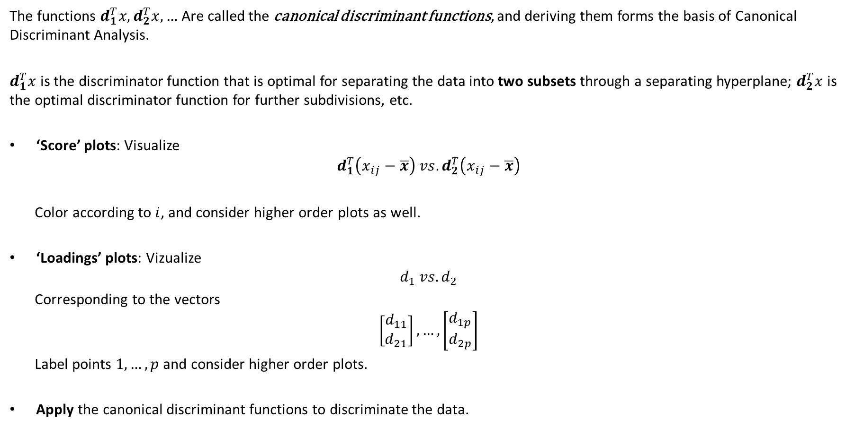
Canonical Discriminant Analysis
The functions $d_{1}^{T}x,d_{2}^{T}x, …$ Are called the canonical discriminant functions, and deriving them forms the basis of Canonical Discriminant Analysis.
$d_{1}^{T}x$ is the discriminator function that is optimal for separating the data into two subsets through a separating hyperplane; $d_{2}^{T}x$ is the optimal discriminator function for further subdivisions, etc.
‘Score’ plots: Visualize
$$d_{1}^{T}\left(x_{ij}−\overline{x}\right) vs.d_{2}^{T}\left(x_{ij}−\overline{x}\right)$$
Color according to $i$, and consider higher order plots as well.
‘Loadings’ plots: Vizualize
$$d_{1} vs. d_{2}$$
Corresponding to the vectors
$$\left[\begin{matrix}d_{11} \\ d_{21}\end{matrix}\right],…,\left[\begin{matrix}d_{1p} \\ d_{2p}\end{matrix}\right]$$
Label points $1,…,p$ and consider higher order plots.
Apply the canonical discriminant functions to discriminate the data.

Slide 46
Example – Psychology Data
A group of 25 NORMAL and 25 PSYCHOTIC individuals were given certain tests.
Two variables SIZE and SHAPE were calculated as proxies.
> psychotic<-read.csv2("Data/psychotic.csv")
> psychotic$group<-as.factor(psychotic$group)
> summary(psychotic)
group size shape
normal :25 Min. : 3.0 Min. : 1.0
psychotic:25 1st Qu.:12.2 1st Qu.: 9.5
Median :19.5 Median :17.0
Mean :16.8 Mean :24.4
3rd Qu.:21.8 3rd Qu.:37.5
Max. :25.0 Max. :62.0

Slide 47
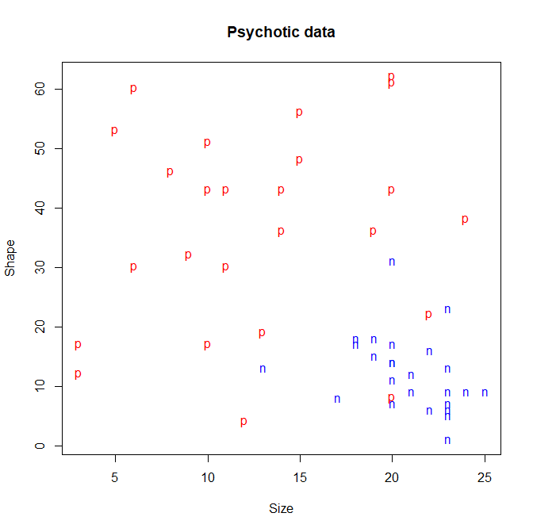
Example – Psychology Data

Slide 48
Example – Psychology Data
We want to construct a decision rule that separates psychotic individuals from normal individuals. Method: canonical discriminant analysis.
Need to construct the fundamental matrices W, B, T.
Data management:
>data.all<-as.matrix(psychotic[,2:3])
>data.normal<-as.matrix(psychotic[psychotic$group=="normal",2:3])
>data.psychotic<-as.matrix(psychotic[psychotic$group=="psychotic",2:3])
>xbar.all<-matrix(rep(1,100),ncol=2)%*%diag(colMeans(data.all))
>xbar.normal<-matrix(rep(1,50),ncol=2)%*%diag(colMeans(data.normal))
>xbar.psychotic<-matrix(rep(1,50),ncol=2)%*%diag(colMeans(data.psychotic))

Slide 49
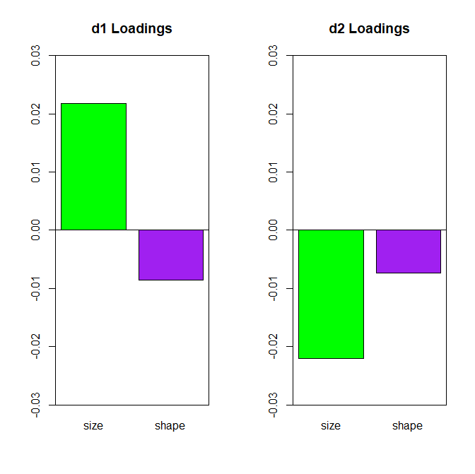
Example – Psychology Data
Constructing the canonical discriminators:
> d1<-eigen(solve(W)%*%B)$vectors[,1]
> d1<-(1/as.numeric(sqrt(t(d1)%*%W%*%d1)))*d1
>
> d2<-eigen(solve(W)%*%B)$vectors[,2]
> d2<-(1/as.numeric(sqrt(t(d2)%*%W%*%d2)))*d2
>
>
> d1
[1] 0.021749 -0.008586
> d2
[1] -0.022049 -0.007325

Slide 50
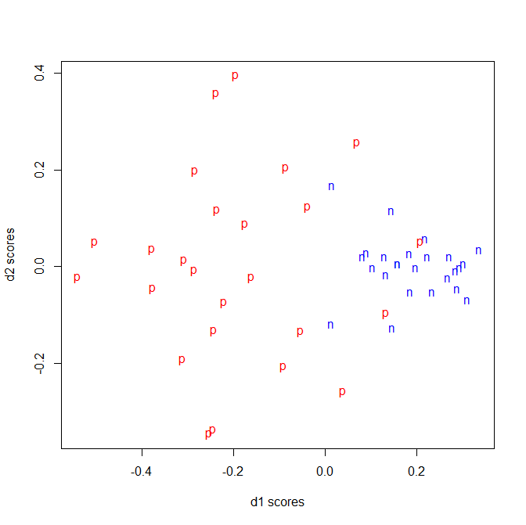
Example – Psychology Data
The score plot:

Slide 51
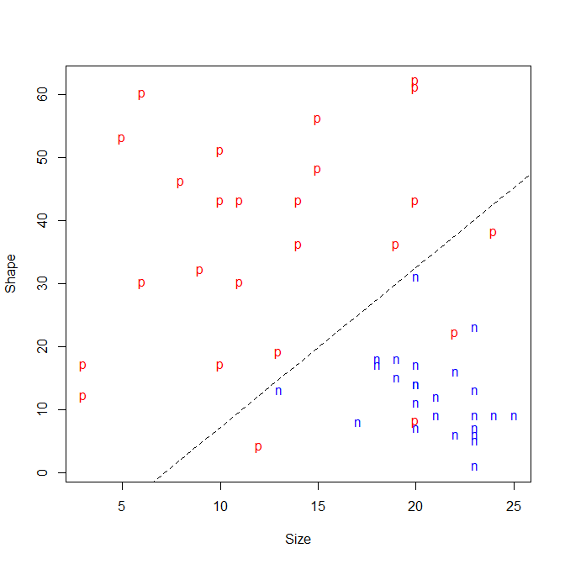
Example – Psychology Data
The canonical
discrimination:

Slide 52
Example – Psychology Data
Constructing W, B, T:
> W_normal<-t(data.normal-xbar.normal)%*%(data.normal-xbar.normal)
> W_psychotic<-t(data.psychotic-xbar.psychotic)%*%(data.psychotic-xbar.psychotic)
>
> W<-W_normal+W_psychotic
> B<-25*(colMeans(data.normal)-colMeans(data.all))%*%
+ t(colMeans(data.normal)-colMeans(data.all))+
+ 25*(colMeans(data.psychotic)-colMeans(data.all))%*%
+ t(colMeans(data.psychotic)-colMeans(data.all))
>
> T<-W+B
>
> W; B; T
size shape
size 1048.0 207.6
shape 207.6 7891.4
size shape
[1,] 800 -2408
[2,] -2408 7248
size shape
size 1848 -2200
shape -2200 15140
W
B
T

Slide 53
Example – Psychology Data
Same analysis using lda function:
> (my.lda<-lda(group ~ size + shape, prior=c(1/2,1/2), data=psychotic) )
Call:
lda(group ~ size + shape, data = psychotic, prior = c(1/2, 1/2))
Prior probabilities of groups:
normal psychotic
0.5 0.5
Group means:
size shape
normal 20.8 12.32
psychotic 12.8 36.40
Coefficients of linear discriminants:
LD1
size -0.15068
shape 0.05949
> d1/my.lda$scaling
LD1
size -0.1443
shape -0.1443
Constant: parallel vectors.
The slope of the discrimination line is the same.

Slide 54
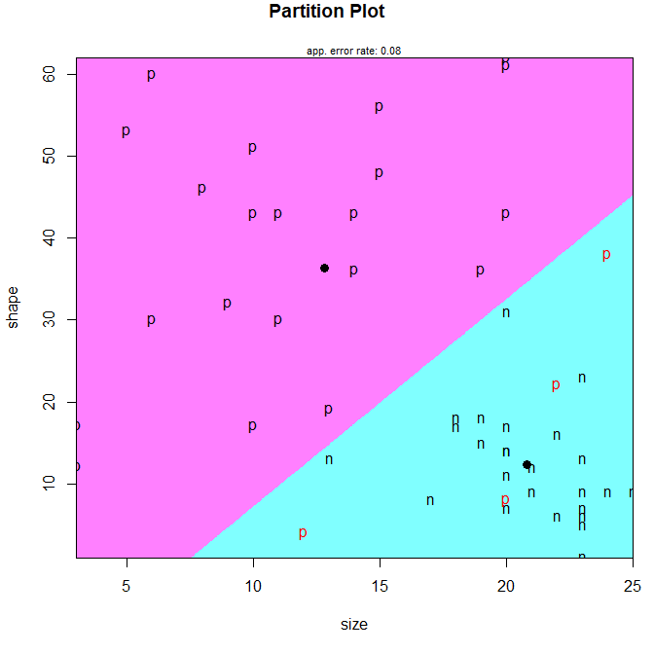
Example – Psychology Data
Discrimination plot using lda:
library(klaR)
partimat(group ~ shape + size, prior=c(1/2,1/2), data=psychotic, method="lda",prec=1000)
Similar to slide 51!

Slide 55
Example – Psychology Data
Confusion matrix:
> table(psychotic$group,predict(my.lda)[[1]],dnn=c("Nature","Classification"))
Classification
Nature normal psychotic
normal 25 0
psychotic 4 21
Error rate: (0+4)/(25+0+4+21)=0.08.
Sensitivity: 21/(21+4)=0.84.

Slide 56
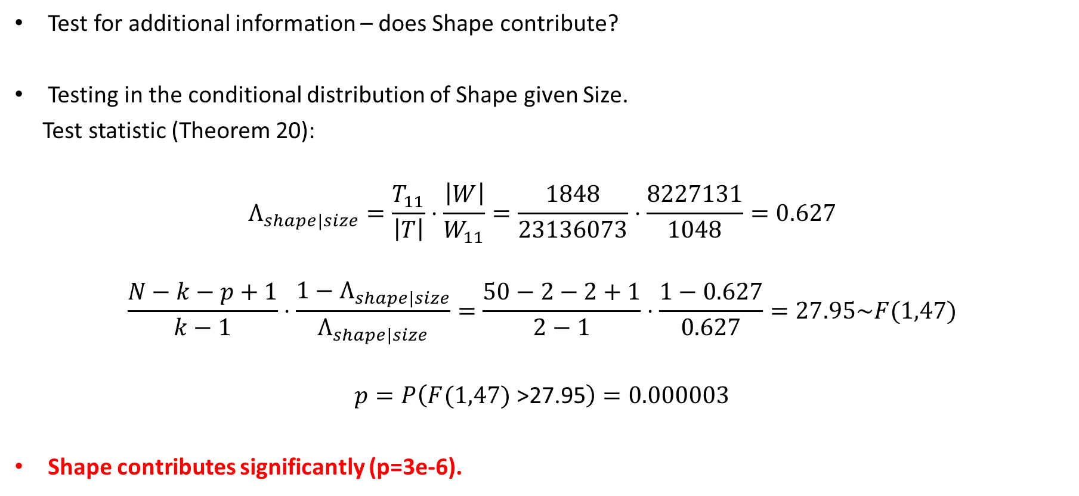
Example – Psychology Data
Test for additional information – does Shape contribute?
Testing in the conditional distribution of Shape given Size.
Test statistic (Theorem 20):
$$Λ_{shape|size}=\frac{T_{11}}{\left|T\right|}⋅\frac{\left|W\right|}{W_{11}}=\frac{1848}{23136073}⋅\frac{8227131}{1048}=0.627$$
$$\frac{N−k−p+1}{k−1}⋅\frac{1−Λ_{shape|size}}{Λ_{shape|size}}=\frac{50−2−2+1}{2−1}⋅\frac{1−0.627}{0.627}=27.95\sim F(1,47)$$
$$p=P\left(F(1,47) \text{>27.95}\right)=0.000003$$
Shape contributes significantly (p=3e-6).

Slide 57
Example – Psychology Data
Is LDA a good idea?
> W_normal/24;W_psychotic/24
size shape
size 6.917 -5.267
shape -5.267 40.893
size shape
size 36.75 13.92
shape 13.92 287.92
Vastly different variances! Psychotic individuals are much more variable!
Taking that into account means Quadratic Discrimination analysis!

Slide 58
Example – Psychology Data
Quadratic discrimination analysis using qda function:
> (my.qda<-qda(group ~ size + shape, prior=c(1/2,1/2), data=psychotic) )
Call:
qda(group ~ size + shape, data = psychotic, prior = c(1/2, 1/2))
Prior probabilities of groups:
normal psychotic
0.5 0.5
Group means:
size shape
normal 20.8 12.32
psychotic 12.8 36.40

Slide 59
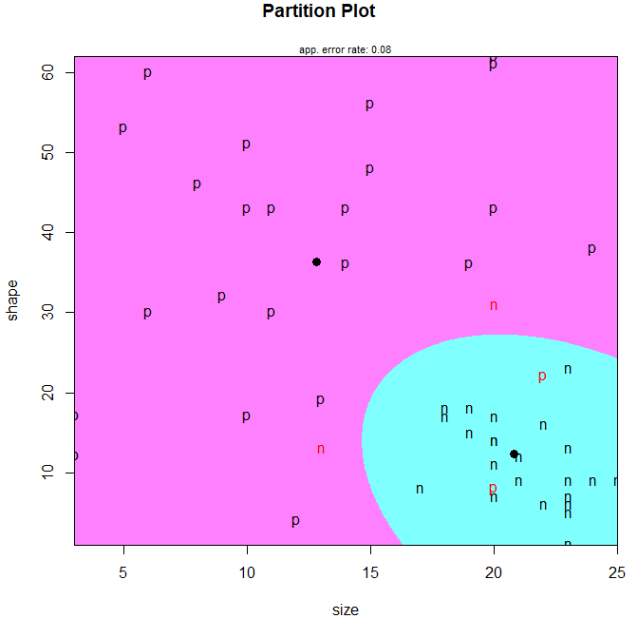
Example – Psychology Data
> partimat(group ~ shape + size, prior=c(1/2,1/2), data=psychotic, method="qda",prec=1000)
Confusion matrix, quadratic discrimination:
>table(psychotic$group,predict(my.qda)[[1]],
>dnn=c("Nature","Classification"))
Classification
Nature normal psychotic
normal 23 2
psychotic 2 23
Error rate: (2+2)/(23+2+2+23) =0.04 (unchanged)
Sensitivity: 23/(2+23)=0.92 (increased).

Slide 60
Example – Iris Data
Measumrents on 50 Iris Setosa, 50 Iris versicolor and 50 Iris virginica plants.
Sepal length, sepal width, petal length and petal width measured in mm.
Original hypothesis:
Versicolor is a hybrid of the two other species.

Slide 61
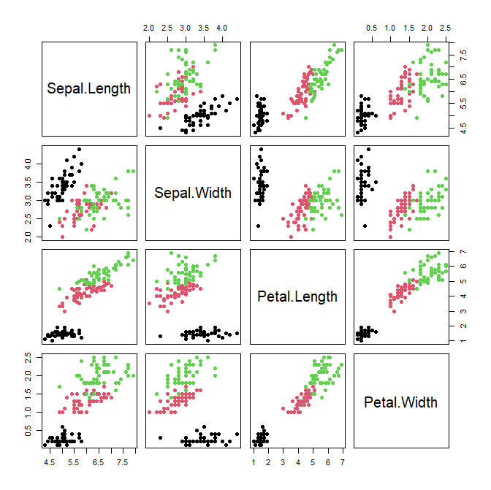
Example – Iris Data
Built-in dataset:
> iris<-datasets::iris
> names(iris)
[1] "Sepal.Length" "Sepal.Width" "Petal.Length"
[2] "Petal.Width" "Species"
> pairs(iris[,1:4], col=iris$Species, pch=19)

Slide 62
Example – Iris Data
We want to construct decision rule that separates species.
Method: canonical discriminant analysis.
We will start by constructing the W’s.
Data management:
iris.all<-as.matrix(iris[,1:4])
iris.setosa<-as.matrix(iris[iris$Species=="setosa",1:4])
iris.versicolor<-as.matrix(iris[iris$Species=="versicolor",1:4])
iris.virginica<-as.matrix(iris[iris$Species=="virginica",1:4])
xbar.all<-matrix(rep(1,4*150),ncol=4)%*%diag(colMeans(iris.all))
xbar.setosa<-matrix(rep(1,4*50),ncol=4)%*%diag(colMeans(iris.setosa))
xbar.versicolor<-matrix(rep(1,4*50),ncol=4)%*%diag(colMeans(iris.versicolor))
xbar.virginica<-matrix(rep(1,4*50),ncol=4)%*%diag(colMeans(iris.virginica))

Slide 63
Example – Iris Data
Constructing W’s:
> W_setosa<-t(iris.setosa-xbar.setosa)%*%(iris.setosa-xbar.setosa)
W_versicolor<-t(iris.versicolor-xbar.versicolor)%*%(iris.versicolor-xbar.versicolor)
W_virginica<-t(iris.virginica-xbar.virginica)%*%(iris.virginica-xbar.virginica)
Variance:
> W_setosa/49
Sepal.Length Sepal.Width Petal.Length Petal.Width
Sepal.Length 0.12425 0.099216 0.016355 0.010331
Sepal.Width 0.09922 0.143690 0.011698 0.009298
Petal.Length 0.01636 0.011698 0.030159 0.006069
Petal.Width 0.01033 0.009298 0.006069 0.011106
>
> W_versicolor/49
Sepal.Length Sepal.Width Petal.Length Petal.Width
Sepal.Length 0.26643 0.08518 0.18290 0.05578
Sepal.Width 0.08518 0.09847 0.08265 0.04120
Petal.Length 0.18290 0.08265 0.22082 0.07310
Petal.Width 0.05578 0.04120 0.07310 0.03911
>
> W_virginica/49
Sepal.Length Sepal.Width Petal.Length Petal.Width
Sepal.Length 0.40434 0.09376 0.30329 0.04909
Sepal.Width 0.09376 0.10400 0.07138 0.04763
Petal.Length 0.30329 0.07138 0.30459 0.04882
Petal.Width 0.04909 0.04763 0.04882 0.07543
Again, vastly different variances.
We will need QDA.

Slide 64
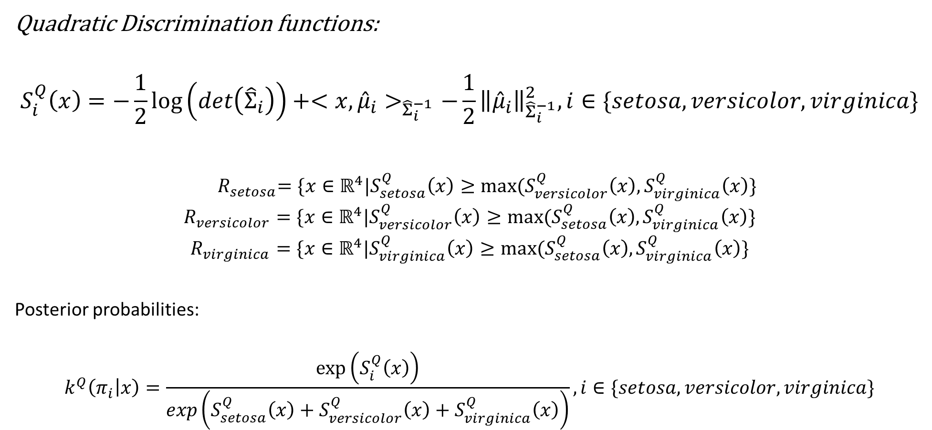
Example – Iris Data
Quadratic Discrimination functions:
$$S_{i}^{Q}\left(x\right)=−\frac{1}{2}\log\left(det\left({\hat{Σ}}_{i}\right)\right)+<x,{\hat{μ}}_{i}>_{{\hat{Σ}}_{i}^{−1}}−\frac{1}{2}{\left\|{\hat{μ}}_{i}\right\|}_{{\hat{Σ}}_{i}^{−1}}^{2}, i∈\{setosa,versicolor,virginica\}$$
$${ R}_{setosa}=\{x∈ℝ^{4}|S_{setosa}^{Q}\left(x\right)≥max⁡(S_{versicolor}^{Q}\left(x\right),S_{virginica}^{Q}\left(x\right)\}$$
$$R_{versicolor}=\{x∈ℝ^{4}|S_{versicolor}^{Q}\left(x\right)≥max⁡(S_{setosa}^{Q}\left(x\right),S_{virginica}^{Q}\left(x\right)\}$$
$$R_{virginica}=\{x∈ℝ^{4}|S_{virginica}^{Q}\left(x\right)≥max⁡(S_{setosa}^{Q}\left(x\right),S_{virginica}^{Q}\left(x\right)\}$$
Posterior probabilities:
$$k^{Q}\left(π_{i} | x\right)=\frac{exp⁡\left(S_{i}^{Q}\left(x\right)\right)}{exp\left(S_{setosa}^{Q}\left(x\right)+S_{versicolor}^{Q}\left(x\right)+S_{virginica}^{Q}\left(x\right)\right)}, i∈\{setosa,versicolor,virginica\}$$

Slide 65

Example – Iris Data
Quadratic Discrimination functions:
$${\hat{μ}}_{setosa}=\left[\begin{matrix}\begin{matrix}5.006 \\ 3.428\end{matrix} \\ \begin{matrix}1.462 \\ 0.246\end{matrix}\end{matrix}\right], {\hat{Σ}}_{setosa}=\left[\begin{matrix}\begin{matrix}\text{0.12425}\text{0} & \text{0.099216} \\ \text{0.0992}16 & \text{0.143690}\end{matrix} & \begin{matrix}\text{0.016355} & \text{0.010331} \\ \text{0.011698} & \text{0.009298}\end{matrix} \\ \begin{matrix}\text{0.0163}55 & \text{0.011698} \\ \text{0.01033} & \text{0.009298}\end{matrix} & \begin{matrix}\text{0.030159} & \text{0.006069} \\ \text{0.006069} & \text{0.011106}\end{matrix}\end{matrix}\right]$$
$$\log\left(\det\left({\hat{Σ}}_{setosa}\right)\right)=−13.07, {\hat{Σ}}_{setosa}^{−1}=\left[\begin{matrix}\begin{matrix}\text{18.943} & \text{−12.405} \\ \text{−12.405} & \text{15.571}\end{matrix} & \begin{matrix}\text{−4.500} & \text{−4.776} \\ \text{1.111} & \text{−2.104}\end{matrix} \\ \begin{matrix}\text{−4.500} & \text{1.111} \\ \text{−4.776} & \text{−2.104}\end{matrix} & \begin{matrix}\text{38.776} & \text{−17.935} \\ \text{−17.935} & \text{106.046}\end{matrix}\end{matrix}\right]$$

Slide 66

Example – Iris Data
Quadratic Discrimination functions:
$${\hat{μ}}_{setosa}=\left[\begin{matrix}\begin{matrix}5.006 \\ 3.428\end{matrix} \\ \begin{matrix}1.462 \\ 0.246\end{matrix}\end{matrix}\right], {\hat{Σ}}_{setosa}=\left[\begin{matrix}\begin{matrix}\text{0.12425}\text{0} & \text{0.099216} \\ \text{0.0992}16 & \text{0.143690}\end{matrix} & \begin{matrix}\text{0.016355} & \text{0.010331} \\ \text{0.011698} & \text{0.009298}\end{matrix} \\ \begin{matrix}\text{0.0163}55 & \text{0.011698} \\ \text{0.01033} & \text{0.009298}\end{matrix} & \begin{matrix}\text{0.030159} & \text{0.006069} \\ \text{0.006069} & \text{0.011106}\end{matrix}\end{matrix}\right]$$
$$\log\left(\det\left({\hat{Σ}}_{setosa}\right)\right)=−13.07, {\hat{Σ}}_{setosa}^{−1}=\left[\begin{matrix}\begin{matrix}\text{18.943} & \text{−12.405} \\ \text{−12.405} & \text{15.571}\end{matrix} & \begin{matrix}\text{−4.500} & \text{−4.776} \\ \text{1.111} & \text{−2.104}\end{matrix} \\ \begin{matrix}\text{−4.500} & \text{1.111} \\ \text{−4.776} & \text{−2.104}\end{matrix} & \begin{matrix}\text{38.776} & \text{−17.935} \\ \text{−17.935} & \text{106.046}\end{matrix}\end{matrix}\right]$$
For example:
S.setosa.Q<-function(x){-(log(det(Sigma.setosa))/2+
t(x)%*%solve(Sigma.setosa)%*% mu.setosa -
t(mu.setosa)%*%solve(Sigma.setosa)%*%mu.setosa/2}

Slide 67
Example – Iris Data
Quadratic Discrimination analysis:
my.qda <-qda(Species ~ Sepal.Length+Sepal.Width + Petal.Length+
Petal.Width, prior=c(1,1,1)/3, data=iris)
Posteriors:
> head(predict(my.qda)[[2]])
setosa versicolor virginica
1 1 4.918517e-26 2.981541e-41
2 1 7.655808e-19 1.311032e-34
3 1 1.552279e-21 3.380440e-36
4 1 8.300396e-19 8.541858e-32
5 1 3.365614e-27 2.010147e-41
6 1 1.472533e-26 1.271928e-40
Classification:
> head(predict(my.qda)[[1]])
[1] setosa setosa setosa setosa setosa setosa
Levels: setosa versicolor virginica

Slide 68

Example – Iris Data

Slide 69
Example – Iris Data
Confusion matrix:
Classification
Nature setosa versicolor virginica
setosa 50 0 0
versicolor 0 48 2
virginica 0 1 49
Error rate: 3/150=0.02

Slide 70

https://cdn-images-1.medium.com/max/638/1*4sixxtuD8unWceZ-yp9TgQ.jpeg
Notes:
We know move from the classification setting to regression. Where in classification we seek to separate or discriminate between classes, in regression we seek to model a continous variable.

Slide 71

The General Linear Model - GLM
$$Y\sim N_{n}\left(μ,σ^{2}Σ\right)$$
$$μ=Xθ$$
$$\left[\begin{matrix}μ_{1} \\ ⋮ \\ μ_{n}\end{matrix}\right]=\left[\begin{matrix}x_{11} & ⋯ & x_{1k} \\ ⋮ & ⋱ & ⋮ \\ x_{n1} & ⋯ & x_{nk}\end{matrix}\right]\left[\begin{matrix}θ_{1} \\ ⋮ \\ θ_{k}\end{matrix}\right]$$
X is the design matrix; assumed known, and with full rank
$Σ$ is assumed known
$σ^{2}$ is assumed unknown

Slide 72

The General Linear Model - GLM
Example: $Σ=I_{n}$ :
$$Y_{i}=\sum_{j=1}^{n}{x_{ij}}θ_{j}+ε_{i}, i=1,…, n, ε_{1},…,ε_{n} iidsv, ε_{1}\sim N\left(0,σ^{2}\right)$$
Standard univariate linear regression.

Slide 73

The General Linear Model - GLM
Take
$$M=\left\{Xθ | θ∈ℝ^{k}\right\}$$
and let $M^{⊥}$ be the orthogonal complement with respect to ${\left\|⋅\right\|}_{Σ^{−1}}$.
Since $ℝ^{n}=M⨁M^{⊥},$ and vector $y∈ℝ^{n}$ may be written uniquely as
$y=y_{1}+y_{2}$ with $y_{1}∈M$ and $y_{2}∈M^{⊥}$
Note that
$$y_{1}=P_{M}y=X{\left(X^{T}Σ^{−1}X\right)}^{−1}X^{T}Σ^{−1}y$$
Notes:
Vis at P_M er surjektiv og idempotent

Slide 74


The General Linear Model - GLM
Estimation:
$$L\left(θ,σ^{2}\right)=k⋅{\left(σ^{2}\right)}^{−\frac{n}{2}}exp\left(−\frac{1}{2σ^{2}}{\left\|Xθ−Y\right\|}_{Σ^{−1}}^{2}\right)$$
ie.
$$ℓ\left(θ,σ^{2}\right)=log\left(L\left(θ,σ^{2}\right)\right)=k_{1}−\frac{n}{2}log\left(σ^{2}\right)−\frac{1}{2σ^{2}}{\left\|Xθ−Y\right\|}_{Σ^{−1}}^{2}$$
$$=k_{1}−\frac{n}{2}log\left(σ^{2}\right)−\frac{1}{2σ^{2}}{\left\|Xθ−P_{M}Y−P_{M^{⊥}}Y\right\|}_{Σ^{−1}}^{2}$$
$$=k_{1}−\frac{n}{2}log\left(σ^{2}\right)−\frac{1}{2σ^{2}}\left({\left\|Xθ−P_{M}Y\right\|}_{Σ^{−1}}^{2}+{\left\|P_{M^{⊥}}Y\right\|}_{Σ^{−1}}^{2}\right)$$
$$xθ∈M:<xθ,P_{M^{⊥}}Y>_{Σ^{−1}}=0$$

Slide 75

The General Linear Model - GLM
$$ℓ\left(θ,σ^{2}\right)=k_{1}−\frac{n}{2}log\left(σ^{2}\right)−\frac{1}{2σ^{2}}\left({\left\|Xθ−P_{M}Y\right\|}_{Σ^{−1}}^{2}−{\left\|P_{M^{⊥}}Y\right\|}_{Σ^{−1}}^{2}\right)$$
Largest in $θ$ if $xθ−P_{M}Y=0;ie.$ if
$$Xθ=X{\left(X^{T}Σ^{−1}X\right)}^{−1}X^{T}Σ^{−1}Y$$
ie. (full rank of $X$)
$$θ={\left(X^{T}Σ^{−1}X\right)}^{−1}X^{T}Σ^{−1}Y=:\hat{θ}$$

Slide 76


The General Linear Model - GLM
Mean and variance of $\hat{θ}$:
$$E\left(\hat{θ}\right)=E\left({\left(X^{T}Σ^{−1}X\right)}^{−1}X^{T}Σ^{−1}Y\right)$$
$$={\left(X^{T}Σ^{−1}X\right)}^{−1}X^{T}Σ^{−1}E\left(Y\right)$$
$$={\left(X^{T}Σ^{−1}X\right)}^{−1}X^{T}Σ^{−1}Xθ=θ$$
$$V\left(\hat{θ}\right)=V\left({\left(X^{T}Σ^{−1}X\right)}^{−1}X^{T}Σ^{−1}Y\right)$$
$$={\left(X^{T}Σ^{−1}X\right)}^{−1}X^{T}Σ^{−1}V\left(Y\right)Σ^{−1}X{\left(X^{T}Σ^{−1}X\right)}^{−1}$$
$$=σ^{2}{\left(X^{T}Σ^{−1}X\right)}^{−1}$$
$$V\left(AY\right)=AV\left(Y\right)A^{T}$$

Slide 77

The General Linear Model - GLM
Estimator for $σ^{2}$:
$$ℓ\left(\hat{θ},σ^{2}\right)=k_{1}−\frac{n}{2}log\left(σ^{2}\right)−\frac{1}{2σ^{2}}{\left\|P_{M^{⊥}}Y\right\|}_{Σ^{−1}}^{2}$$
Largest if
$$−\frac{n}{σ^{2}}+\frac{1}{2σ^{4}}{\left\|P_{M^{⊥}}Y\right\|}_{Σ^{−1}}^{2}=0,$$
ie.
$$σ^{2}=\frac{1}{n}{\left\|P_{M^{⊥}}Y\right\|}_{Σ^{−1}}^{2}={\tilde{σ}}^{2}.$$

Slide 78


The General Linear Model - GLM
${\tilde{σ}}^{2}$ is biased:
$$E\left(n{\tilde{σ}}^{2}\right)=E\left(tr\left({\left(P_{M^{⊥}}Y\right)}^{T}Σ^{−1}P_{M^{⊥}}Y\right)\right)$$
$$=E\left(tr\left({\left(Y−xθ\right)}^{T}P_{M^{⊥}}Σ^{−1}P_{M^{⊥}}\left(Y−xθ\right)\right)\right)$$
$$={tr\left(P_{M^{⊥}}Σ^{−1}P_{M^{⊥}}E\left(\left(Y−xθ\right){\left(Y−xθ\right)}^{T}\right)\right)}_{ }$$
$$=tr\left(P_{M^{⊥}}Σ^{−1}P_{M^{⊥}}V\left(Y\right)\right)$$
$$=σ^{2}tr\left(P_{M^{⊥}}Σ^{−1}P_{M^{⊥}}Σ\right)$$
$$=σ^{2}tr\left(P_{M^{⊥}}Σ^{−1}\left(I−P_{M}\right)Σ\right)$$
$$=σ^{2}tr\left(P_{M^{⊥}}(I_{n}+0)\right)=σ^{2}tr\left(P_{M^{⊥}}\right)=σ^{2}\left(n−k\right)$$
Unbiased estimator:
$${\hat{σ}}^{2}=\frac{1}{n−k}{\left\|P_{M^{⊥}}Y\right\|}_{Σ^{−1}}^{2}=\frac{1}{n−k}{\left(Y−X\hat{θ}\right)}^{T}Σ^{−1}\left(Y−X\hat{θ}\right)$$
$tr\left(AB\right)=tr\left(BA\right)$ and linearity of $tr$

Slide 79
The General Linear Model - GLM

Slide 80
The General Linear Model - GLM

Slide 81
The General Linear Model - GLM

Slide 82
GLM in R
The lm() function.
synprod <- data.frame("Acontent"=c(1,0,0.5),
"Bcontent"=c(0,1,0.5),
"Qual"=c(90,30,75))
glmSyn <- lm(Qual ~ Acontent + Bcontent - 1, data=synprod)
# the "-1" in the line above removes the intercept
# If not specified an intercept is estimated by default

Slide 83
GLM in R
glmSyn <- lm(Qual ~ Acontent + Bcontent - 1, data=synprod)
> summary(glmSyn)
Call:
lm(formula = Qual ~ Acontent + Bcontent - 1, data = synprod)
Residuals:
1 2 3
-5 -5 10
Coefficients:
Estimate Std. Error t value Pr(>|t|)
Acontent 95.00 11.18 8.497 0.0746 .
Bcontent 35.00 11.18 3.130 0.1968
---
Signif. codes: 0 ‘***’ 0.001 ‘**’ 0.01 ‘*’ 0.05 ‘.’ 0.1 ‘ ’ 1
Residual standard error: 12.25 on 1 degrees of freedom
Multiple R-squared: 0.9897, Adjusted R-squared: 0.9692
F-statistic: 48.25 on 2 and 1 DF, p-value: 0.1013

Slide 84
Exercises
Exercise 6.4: ”Pen & paper” on CDF
Exam 2011 Q. 3.3-3.6 : Classification
Exam 2009 Problem 1 : Classification
Exercise 3.1 and 3.2: GLM

